Slide 1
GRAAD 4 & 5 THE MUSIC STAFF
PERFOMRING ARTS
Monday 27 April 2020

Slide 2
THE MUSIC STAFF: The music staff consist of: * 5 lines & * 4 spaces (see next slide for example)

Slide 3
x5 Lines.....
x4 Spases....
THE MUSIC STAFF:
5
4
4
3
3
2
2
1
1

Slide 4
The Lines and Spaces can be mixed:
L
L
L
L
L
S
S
S
S
5
4
4
3
3
2
2
1
1

Slide 5
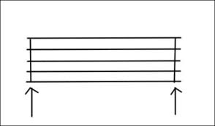
THE BAR AND BARLINE: The music staff can be divided into smaller pieces called a bar by putting barlines onto the staff

Slide 6
Music staff
Bar 1
Bar 2
Final barline
barline
barline
barline

Slide 7
HOMEWORK:
Draw x4 music staffs on a “black” piece of paper
Write the 5 notes on the lines on the second staff
Write the 4 notes in the spaces on the third staff
Mix the lines and spaces on the 4 fourth staff
Do the worksheet provided to you

Slide 8
MEMORANDUMS:
Memorandums of the whole week will be given to you on Friday 1 May

