Slide 1
GRAAD 4 Making instruments from found objects
PERFOMRING ARTS
Monday 11 May2020

Slide 2
Instruments from ‘anything at all’:
We can make instruments from just about anything at all...........
For example:
Recycled material or
Everyday objects
(stones, shells, cans, seeds, pipes, plastic, glass, bottles, sticks, paper etc.)

Slide 3
When we hear a particular sound, it brings to mind and image or feeling because of what we connect with that sound.
For example:
the sound of gentle rain could be relaxing

Slide 4
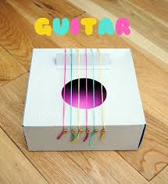
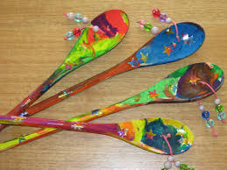
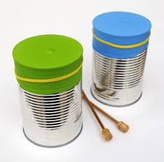
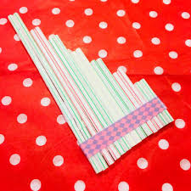
Examples of self-made instruments:

Slide 5
HOMEWORK:
You are going to make your own instrument with materials you can find at home.
When your instrument is finished, you can send a picture on the google classroom group.

Slide 6
MEMORANDUMS:
Memorandums of the whole week will be given to you on Friday 1 May

