Slide 1
GRAAD 4 & 5 THE MUSIC ALPHABET
PERFOMRING ARTS
Monday 28 April 2020

Slide 2
THE MUSIC ALPHABET
When moving backwards, the pitch goes lower
A B C D E F G
When moving forwards, the pitch goes higher
A B C D E F G
A B C D E F G
A B C D E F G
G
In music, only the first 7 letters of the alphabet is used
F
It stops at G, and then starts with A again
E
D
C
B
A

Slide 3
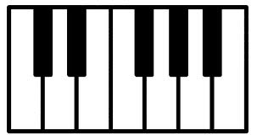
This is the alphabet on the piano....
B is the “bum” of the forks
D sits in die middle of the DONKEY EARS
F shows the beginning of the FORKS
WHEN YOU CAN REMEMBER THESE TIPS, THE REST CAN BE WORKED OUT
DONKEY EARS
FORKS
(F)
C
D
E
F
G
A
B

Slide 4
HOMEWORK:
Do the worksheet provided to you

Slide 5
MEMORANDUMS:
Memorandums of the whole week will be given to you on Friday 1 May

