Slide 1
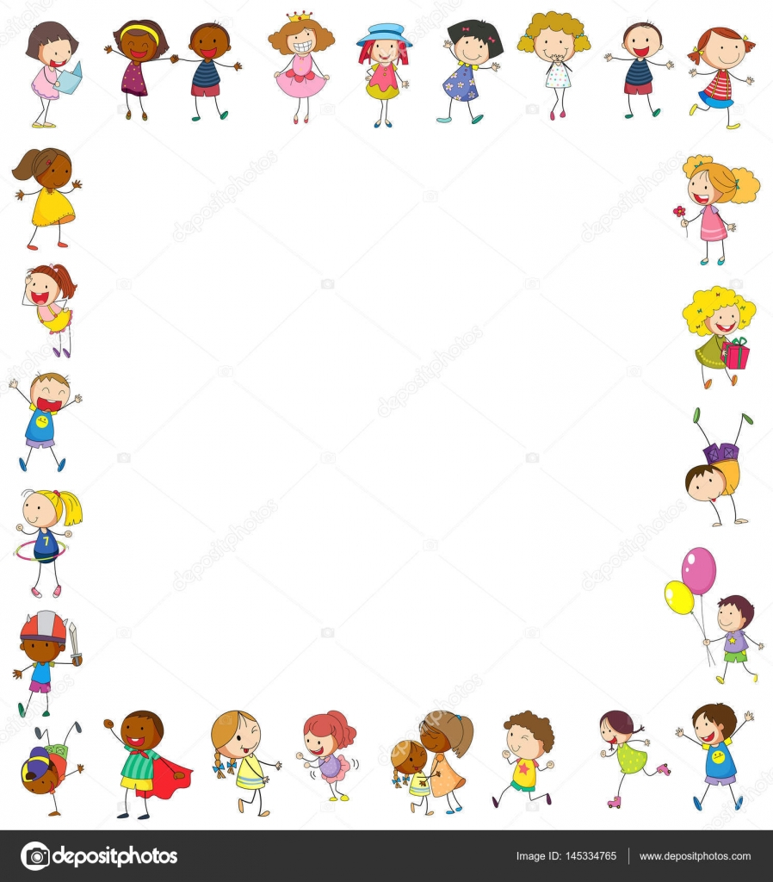
Dear Grade 2 Parents and Learners,
Welcome to Afrikaans at home: Week 3
The following document has the Afrikaans for this week. We will be doing Afrikaans on Tuesdays and Thursdays.
It is indicated at the top of each page on which day the work should be done.
Please make sure that you turn the sound up so that you can hear the teacher.

Slide 2
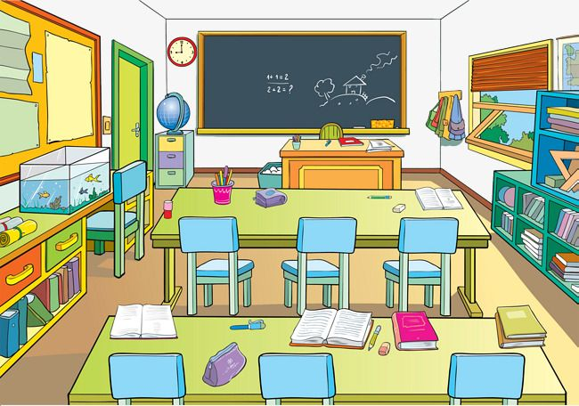
In die klaskamer

Slide 3
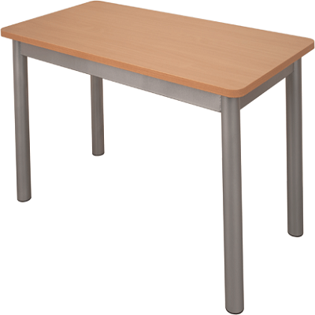
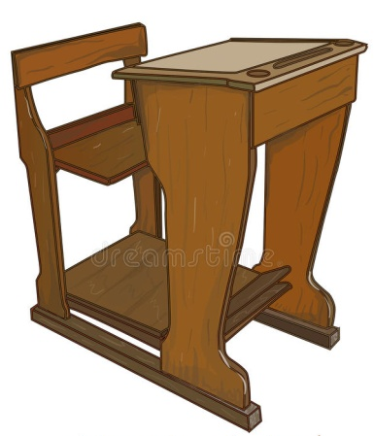
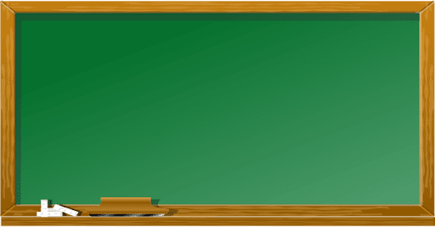
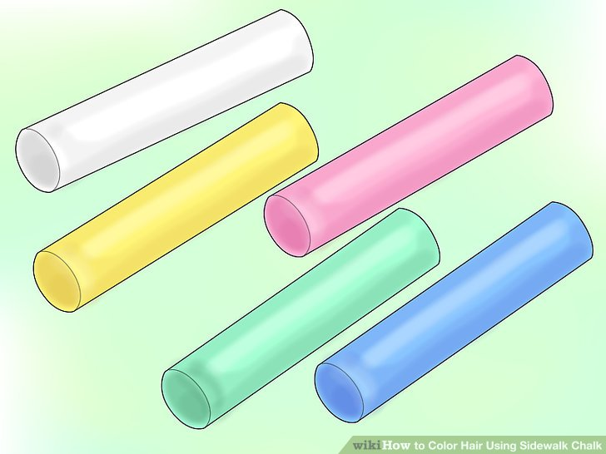
Dinsdag (Tuesday)
stoel
tafel
bank
bord
bordkryt

Slide 4
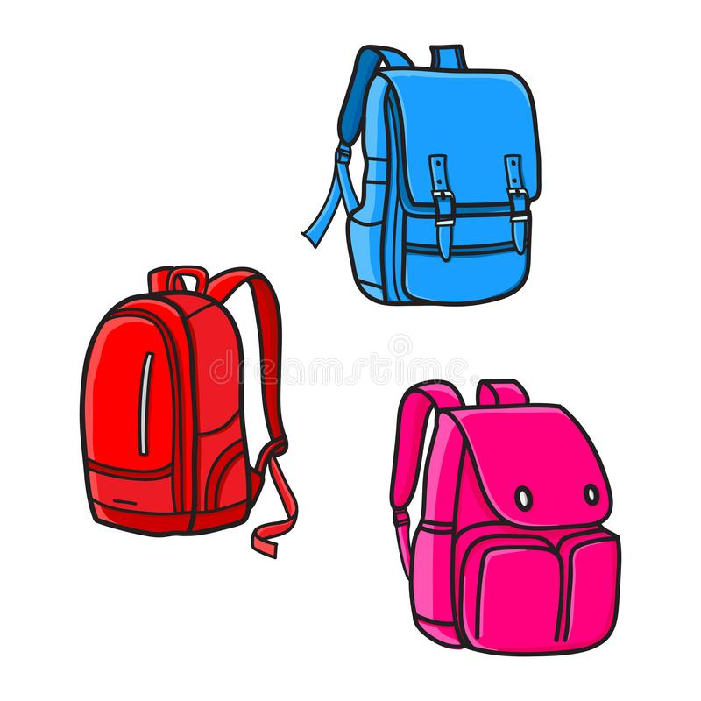
Dinsdag (Tuesday)
pen
liniaal
potlood
stoel
boek
papier
skooltas

Slide 5
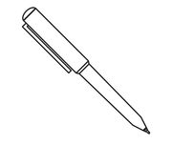
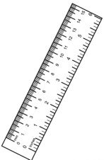
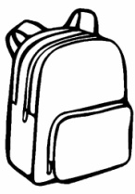
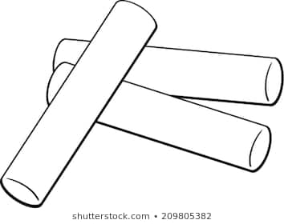
Dinsdag (Tuesday)
Fill in the words below, or write the English word in your book and then write the matching Afrikaans word next to it.
boek potlood papier liniaal
stoel pen bordkryt skooltas
chair - ________
pencil - ________
ruler - ________
book - _________
pen - ________
paper - ________
bag - ________
chalk - _________

Slide 6
Look at the picture.
Read the sentences on the next slide and write them all down.
Underline the sentence that is true.
Lettie
Mandla
Frans
Thandi

Slide 7
Dinsdag (Tuesday)
Example:
Die kinders staan. Die kinders sit.
Lettie is ‘n meisie. Lettie is ‘n seun.
Frans is ‘n seun. Frans is ‘n meisie.
Ek sien vyf kinders. Ek sien tien kinders.
Ek sien boeke. Ek sien ‘n skooltas.

Slide 8
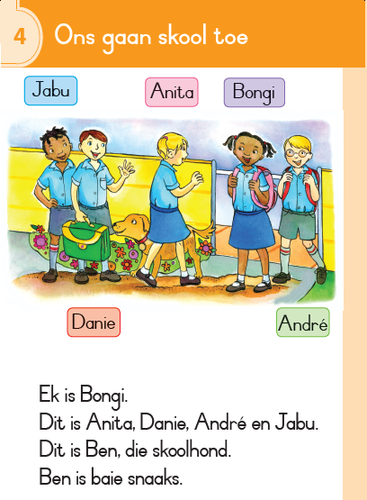
Kom
ons
lees

Slide 10
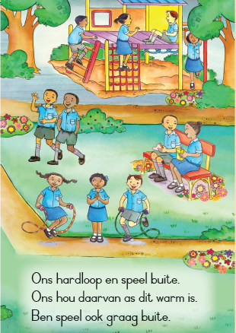

Slide 11
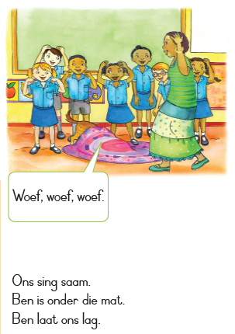

Slide 12
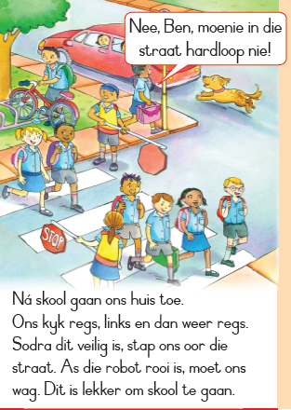

Slide 13
Die Einde!
Sien jou Donderdag
(See you Thursday)

Slide 14
Donderdag (Thursday)

Slide 15
Donderdag (Thursday)
stoel
tafel
bank
bord
bordkryt

Slide 16
Donderdag (Thursday)
pen
liniaal
potlood
stoel
boek
papier
skooltas

Slide 17
Choose the correct picture to match the sentence. Write down the complete sentence in your book. Use the slides to help you.
E.g Ek lees my... boek .
Ek sit op die ____________ .
Ek skryf met die ___________ .
Ek trek ‘n lyn met my ___________ .
Ek sit my boek in my ___________ .
Ek skryf op die bord met ___________ .
Ek teken met my ______________ .

Slide 18
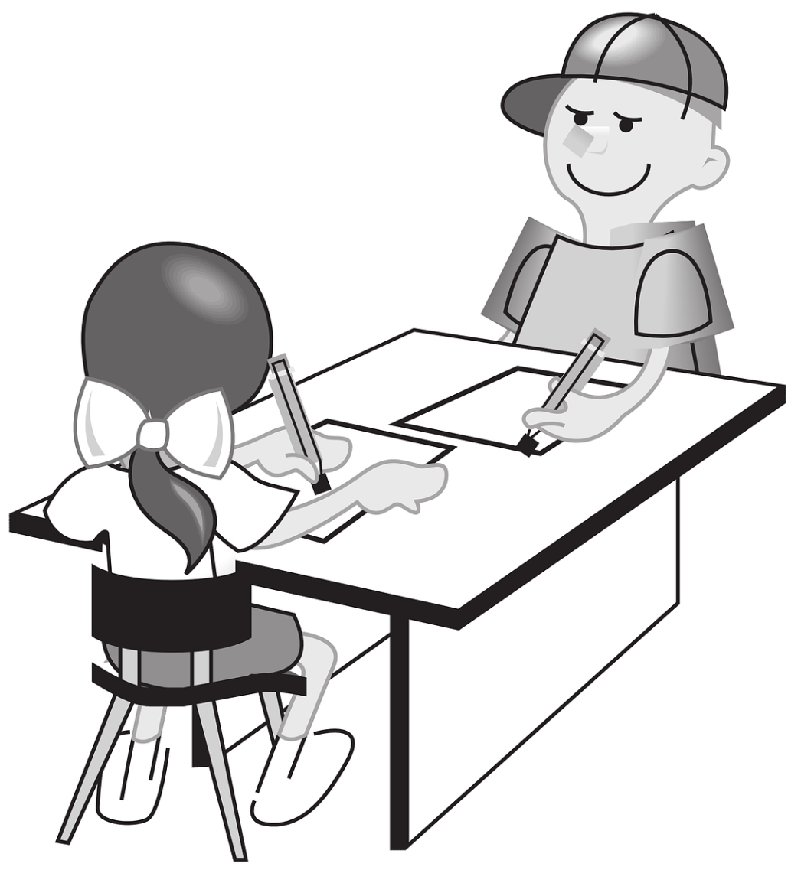
Donderdag (Thursday)
Choose 5 objects that we get in the classroom and make your own sentences.
- E.g Ek sit by my tafel.

Slide 19
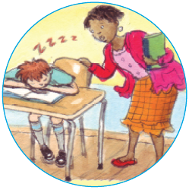
Lees tyd!
Danie se slegte week

Slide 20
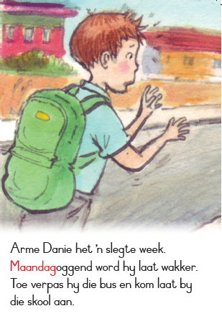

Slide 21
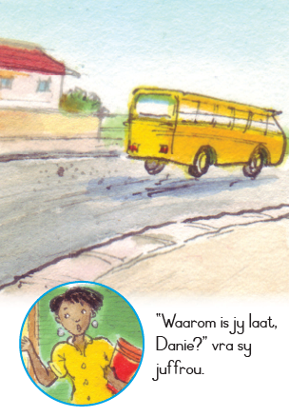

Slide 24
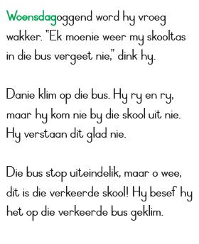

Slide 26
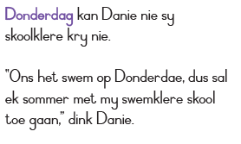

Slide 28
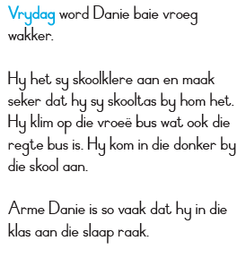

Slide 29
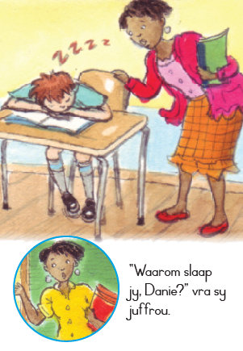

Slide 30
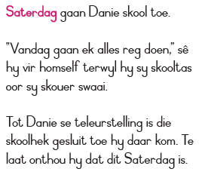

Slide 31
