Slide 1
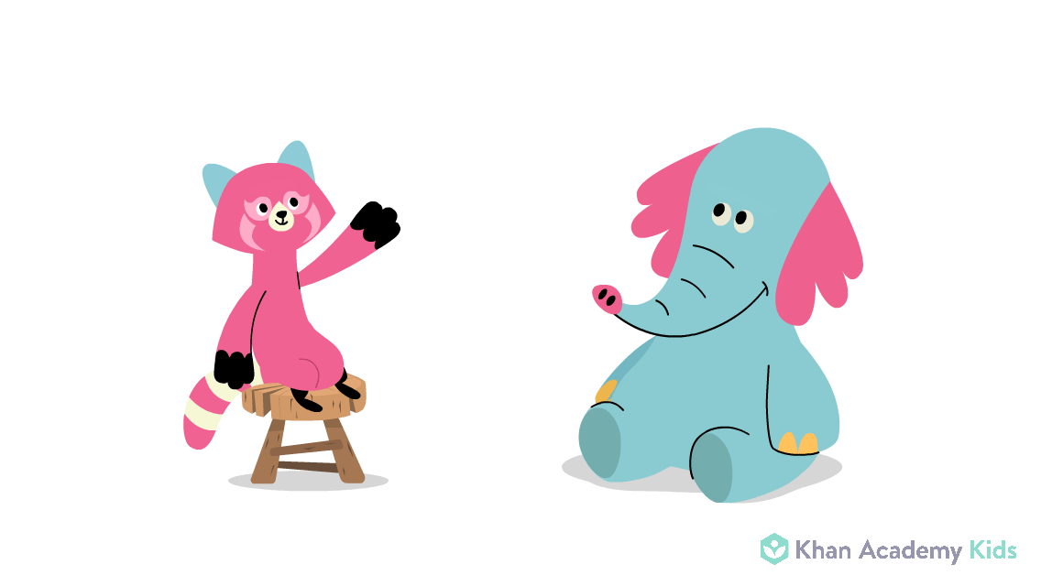
Punctuation

Slide 2
Capital letters
You use a capital letter :
At the beginning of a sentence.
All names get capital letters.
The word I.
Days of the week.
Names of months.

Slide 3
Use a full stop at the end of a sentence.

Slide 4
Use commas to separate words in lists.
I went to the shops and I bought books, pencils, pens and a ruler.
There is no comma before the word AND.

Slide 5
Use a question mark at the end of a question sentence.
?
Who knows how to use a question mark?

Slide 6
Use an exclamation mark at the end of a sentence when you want to show strong emotion.
!
Oh no, you broke my toy!
Pick up that toy right now!

