Slide 1
Spelling Unit 17

Slide 2
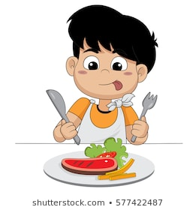
Read the word. Look at the picture.
eat
I use my knife and fork when I eat.
Think of your own sentence using the word. Say it aloud.

Slide 3
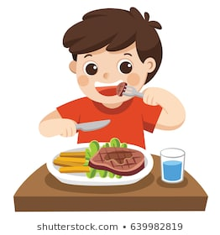
Read the word. Look at the picture.
meat
I eat meat and vegetables for dinner.
Think of your own sentence using the word. Say it aloud.

Slide 4
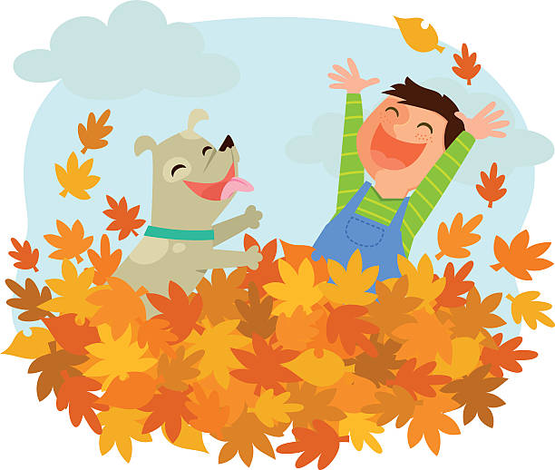
Read the word. Look at the picture.
heap
I like to jump into a heap of leaves.
Think of your own sentence using the word. Say it aloud.

Slide 5
Read the word. Look at the picture.
leaf
These are pretty autumn leaves. I see one red leaf.
Think of your own sentence using the word. Say it aloud.

Slide 6
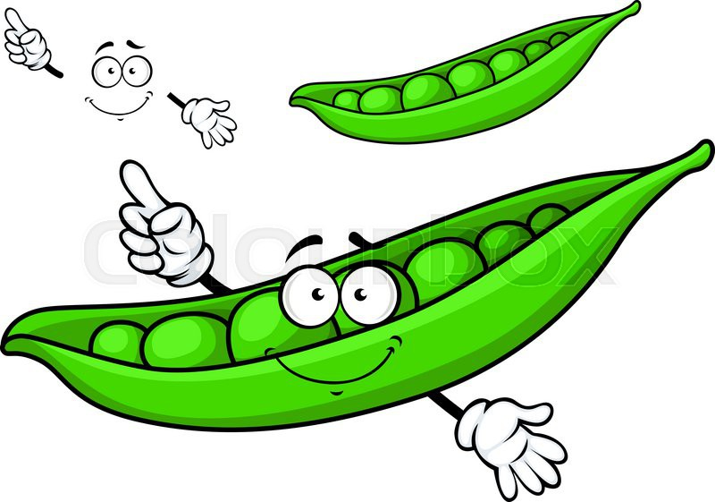
Read the word. Look at the picture.
pea
People enjoy eating green peas.
Think of your own sentence using the word. Say it aloud.

Slide 7
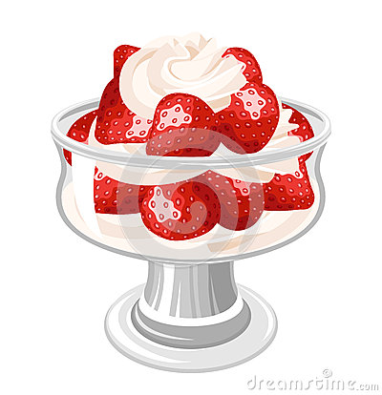
Read the word. Look at the picture.
cream
I love strawberries and cream for dessert.
Think of your own sentence using the word. Say it aloud.

Slide 8
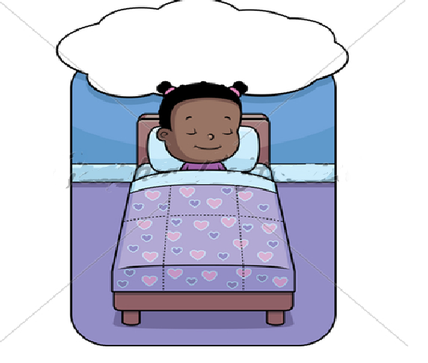
Read the word. Look at the picture.
dream
When I fall asleep in my cosy bed, I have good dreams.
Think of your own sentence using the word. Say it aloud.

Slide 9
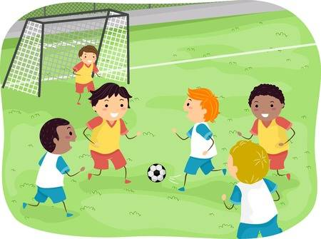
Read the word. Look at the picture.
team
My soccer team is the best !
Think of your own sentence using the word. Say it aloud.

Slide 10
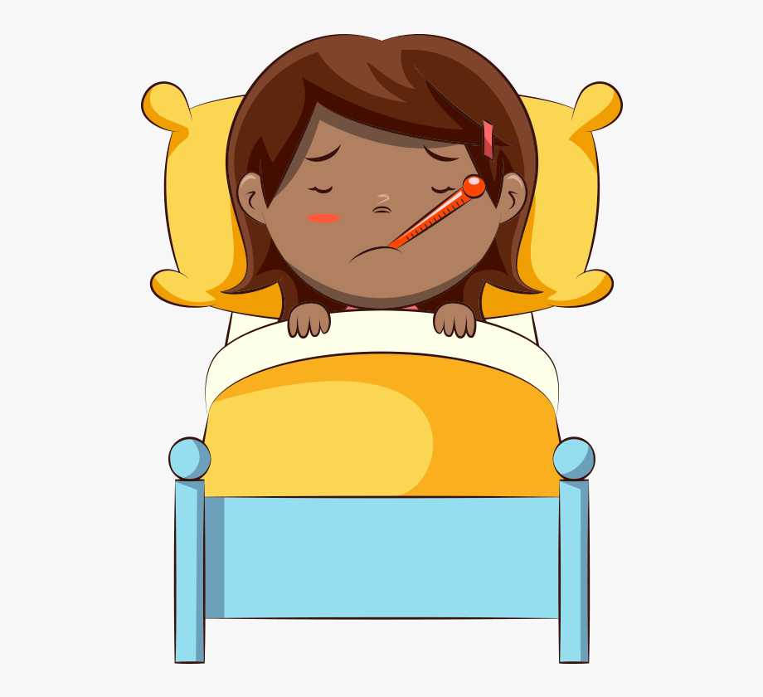
Read the word. Look at the picture.
weak
I feel weak when I am sick.
Think of your own sentence using the word. Say it aloud.

Slide 11
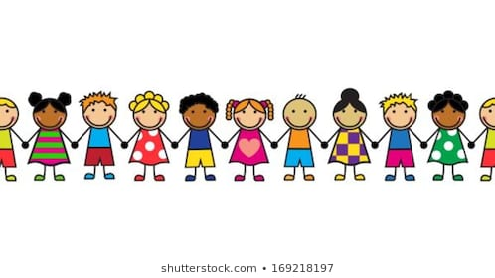
Read the word. Look at the picture.
each
Each child held hands with the children next to them.
Think of your own sentence using the word. Say it aloud.

