Slide 1
Read the word. Look at the picture.
ear
I listen well with my ears.
Think of your own sentence using the word. Say it aloud.

Slide 2
Read the word. Look at the picture.
hear
I hear lovely sounds around me.
Think of your own sentence using the word. Say it aloud.

Slide 3
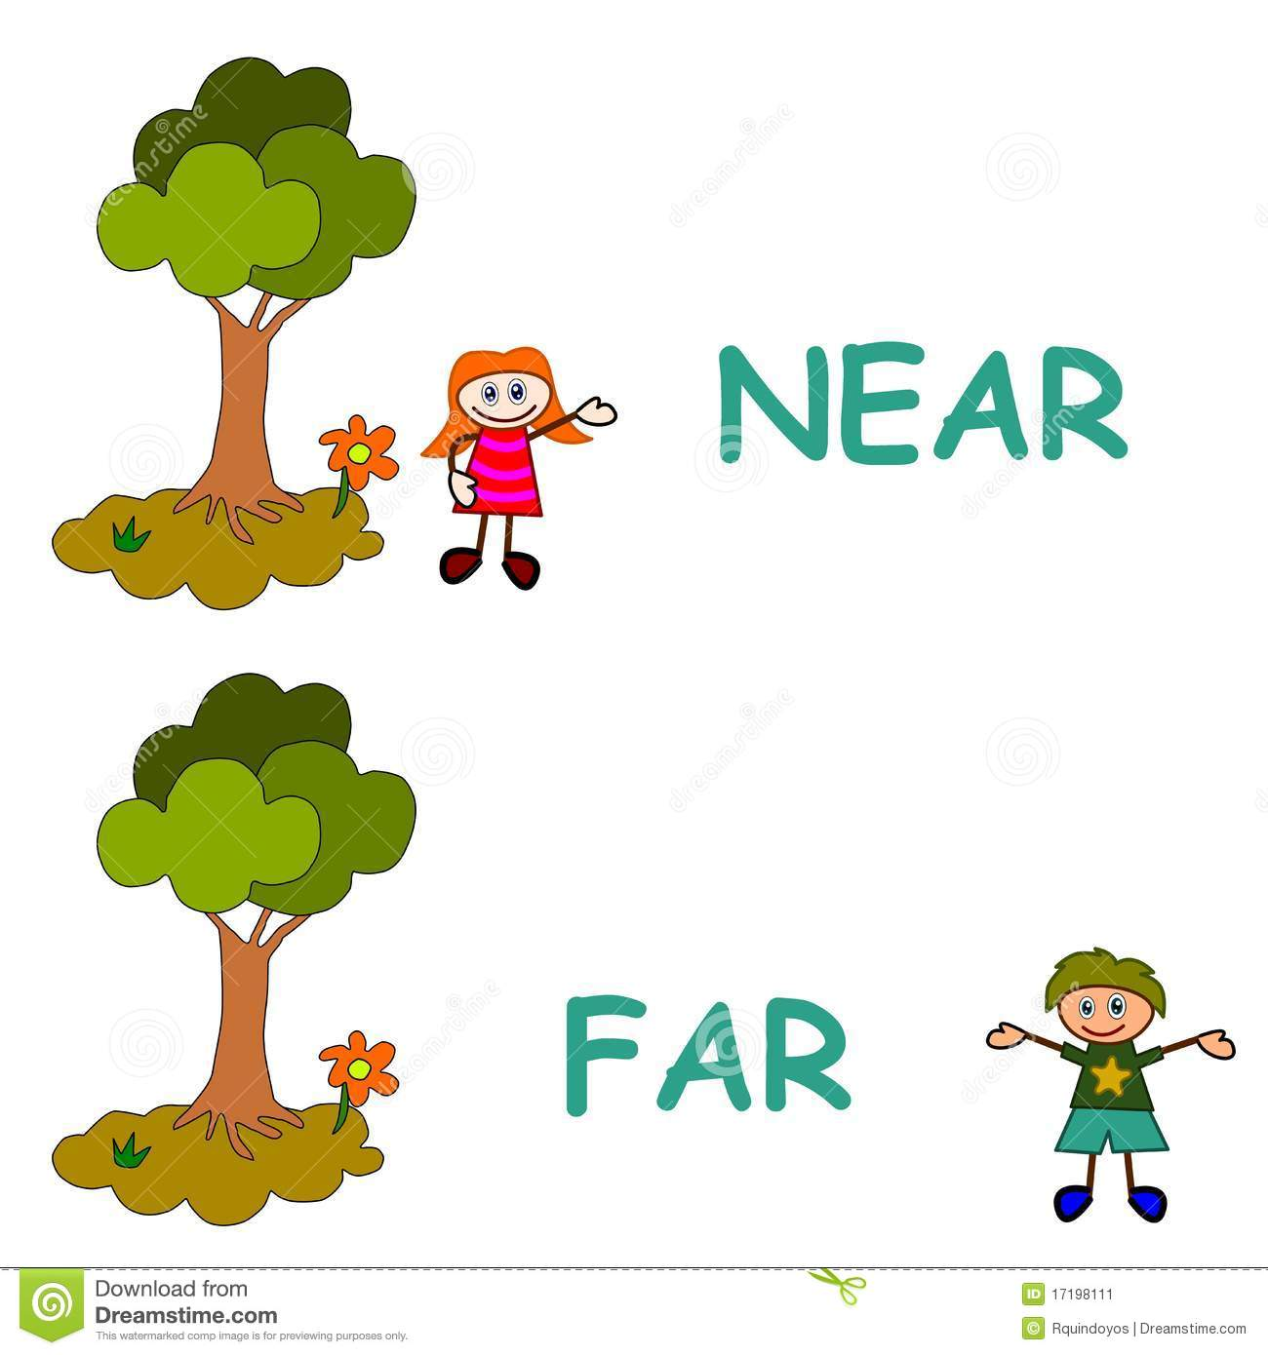
Read the word. Look at the picture.
near
The girl is very near to the tree.
Think of your own sentence using the word. Say it aloud.

Slide 4
Read the word. Look at the picture.
year
My family and I have a party at the end of the year.
Think of your own sentence using the word. Say it aloud.

Slide 5
Read the word. Look at the picture.
fear
I fear I will have a bad dream.
Think of your own sentence using the word. Say it aloud.

Slide 6
Read the word. Look at the picture.
dear
A puppy can be a dear friend.
Think of your own sentence using the word. Say it aloud.

Slide 7
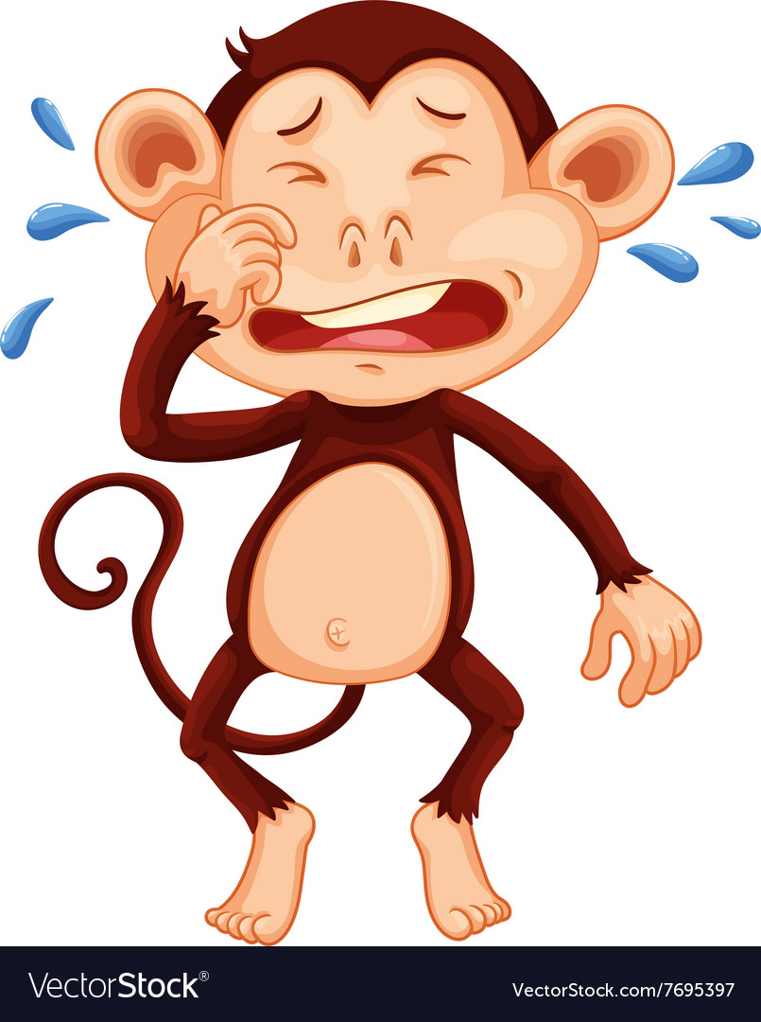
Read the word. Look at the picture.
tear
We cry many tears when we are upset.
Think of your own sentence using the word. Say it aloud.

Slide 8
Read the word. Look at the picture.
clear
The water is blue and clear.
Think of your own sentence using the word. Say it aloud.

Slide 9
Read the word. Look at the picture.
spear
Long ago man used a spear to hunt.
Think of your own sentence using the word. Say it aloud.

Slide 10
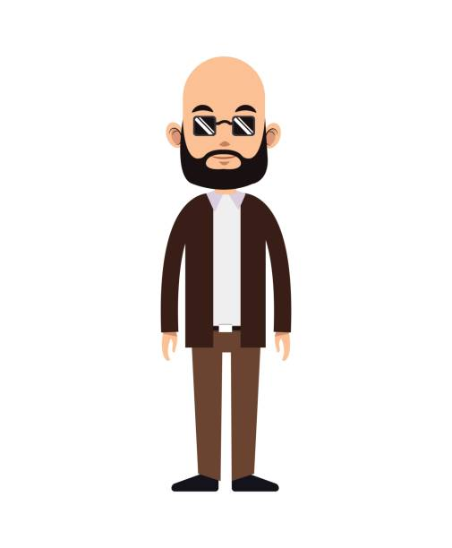
Read the word. Look at the picture.
beard
My grandfather has a beard.
Think of your own sentence using the word. Say it aloud.

