Slide 1
Summarising
Getting to the Point

Slide 2
Summarising
Retell a story in your own words.
Use a few words to tell the most important parts of the story.
Keep it short.
Don’t forget who, what, when, where, why and how.

Slide 3
Practice
Summarising nursery rhymes.
Directions
Read each nursery rhyme.
Summarise the nursery rhyme in as few words as possible.
Include key information.
Check your answers.

Slide 4
1
The itsy bitsy spider
Climbed up the water spout
Down came the rain and
Washed the spider out
Up came the sun and
Dried up all the rain
And the itsy bitsy spider
Climbed up the spout again.

Slide 5
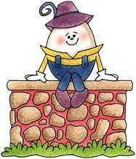
2
Humpty Dumpty Sat on a wall. Humpty Dumpty Had a great fall. All the King's horses And all the King's men Couldn't put Humpty Together again.

Slide 6
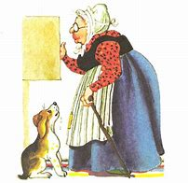
3
Old Mother Hubbard Went to the cupboard To give her poor dog a bone. But when she got there The cupboard was bare, And so the poor dog had none.

Slide 7
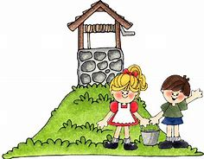
4
Jack and Jill went up the hill, To fetch a pail of water. Jack fell down and broke his crown, And Jill came tumbling after. Up Jack got and home did trot, As fast as he could caper, And went to bed to mend his head With vinegar and brown paper.

Slide 8
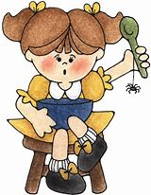
5
Little Miss Muffet Sat on a tuffet, Eating some curds and whey. Along came a spider Who sat down beside her And frightened Miss Muffet away.

Slide 9
Example Answers
A spider fell but got up again.
An egg fell and was irreparably broken.
A woman had no food to feed her dog.
A boy fell, hurt his head, and bandaged it.
A spider scared a girl away.

Slide 10
Read the text until you understand it.
Identify the most important points.
Take notes.
Write your summary from your notes.
Check your summary against the original.
Revise and edit your summary for errors.
5 Steps to Writing a Summary

