Slide 1


abuse
GRADE 7
LIFE ORIENTATION
MISS.LANDSBERG’S CLASS
Page: 78-83 in Textbook

Slide 2

ABUSE is extremely serious!
Name the ways in which ABUSE can occur?
Abuse can occur in 3 ways.
Abuse can occur between 2 adults, 2 peers and between an adult and a child.
There are 5 TYPES of ABUSE: Physical, Emotional, Verbal, Cyber and Sexual.
All examples are in your book and in the revision PowerPoint.
Identifying risky situations: ( Here are a few sentences to read through and remember ).
You have the responsibility to be cautious in order to avoid any risky situations.
Don't go to places alone or into areas that are dangerous alone.
Always remember that abuse can happen to anyone.
Your parents have provided TIPS on how to be safe and look after yourself- keep those in mind.
You may find yourself in a situation where you feel uncomfortable, try remove yourself from the situation.

Slide 3

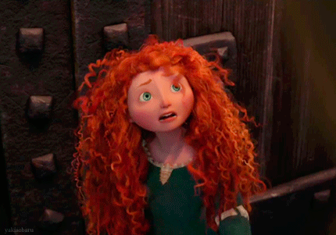
Effects of abuse on personal & social health and relationships
When someone is abused it affects all aspects of their lives.
It damages their self-image and their confidence.
It can be confusing and stressful for something ( any kind of abuse ) to happen to you, without your permission.
Teens that have been abused might have trouble concentrating, eating and sleeping.
School work may be affected because they feel angry, scared and just don’t care anymore.
They may feel they cannot trust anyone anymore.
They may move away from their friends ( anti-social behaviour).
They may turn to drugs or alcohol.
These children may also become depressed.

Slide 4

Communication is key!
Importance of communication to promote healthy and non-violent relationships
In many cases people are abused as children who then become adults who also abuse children.
The cycle continues or happens because they have never resolved the problem or don’t know better.
In healthy relationships, people communicate.
This includes sharing ideas, news, needs and feelings.
Healthy relationships make us feel loved, valued and understood.
Healthy, non-violent relationships are fun.
When communication is good, we feel supported by others and know that the personal things we tell them will be kept private.
On the next slide is a table showing the difference between a Healthy and Unhealthy relationship.

Slide 5
Healthy & Unhealthy Relationships ( Table )
HEALTHY RELATIONSHIPS | UNHEALTHY RELATIONSHIPS
People who do not tell each other lies. | People cannot trust each other because often what they say is untrue.
People listen to each other so there is a chance to explain feelings or give reasons for something happening. | People shout or punish physically rather than discuss the situation.
Disagreements happen- stay calm and talking about your feelings helps us work out ways to solve problems without violence. | Disagreements and fights are resolved with threats and violence ( physical force or intimidation).
People trust and respect each other. Each person will compromise in order to agree. | People do not listen or accept views other than their own.
People talk about their problems and try help each other solve them. | People may be selfish and often are not interested in helping anyone else.
OPPOSITE

