Slide 1
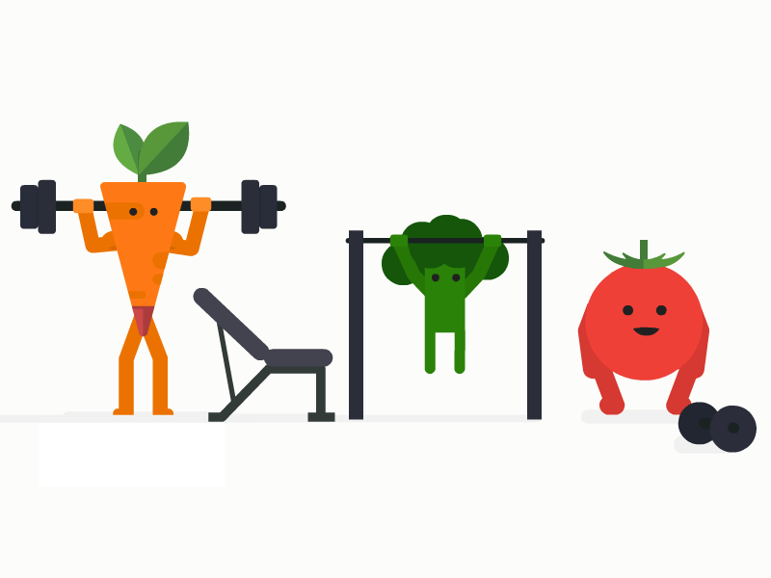
GRADE 4
PHYSICAL EDUCATION

Slide 2
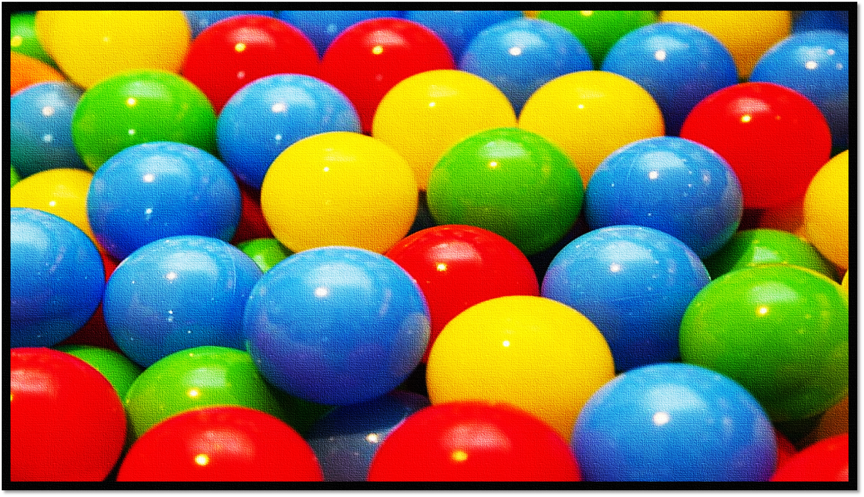
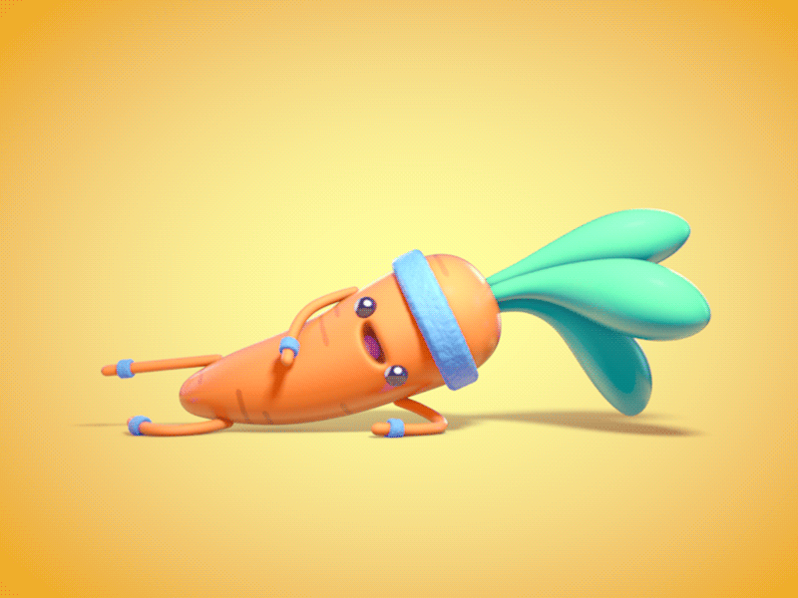
Let’s get MOVING Grade 4’s!
It is extremely IMPORTANT to keep moving, keep fit and keep healthy.
Make sure to complete all the activities provided on a safe surface.
Make sure to complete the warm-up first before you continue
with the activity.
Today we will be Throwing & Catching!
This will be followed by a few fitness activities.
GOOD LUCK!!

Slide 3
READY----GET SET----GO!
WARM-UP: Jumping Jacks- ( as many as you can in 3 MINUTES )
ACTIVITY:
(FIND A BALL OR SOMETHING SMALL AND ROUND TO HELP YOU WITH THIS ACTIVITY-).
Throw the ball up 20 times, then as high as you can for another 20 throws.
Now throw the ball from your left hand to you right (slowly) 30 times , then go as fast as you can for another 30 throws. Watch the ball carefully- if you drop it again, you have to start again.
Now it is time to increase the difficulty- You have to do high knees while repeating Number (2)
If you have someone to throw the ball to create a throwing games, or create a safe target and see how many times you can hit the target.
Lastly- find an open space and sit carefully.
Complete a sit-up challenge- do as many SIT-UPS as you possibly can without stopping.
COOL DOWN: Stretching your entire body from head to toe. ( Make sure all stretches last at least 10 secs.)

