Slide 1
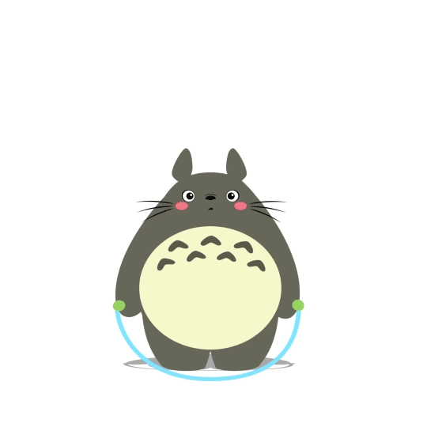
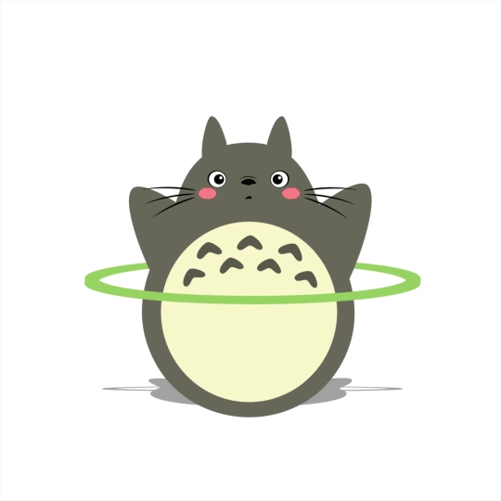
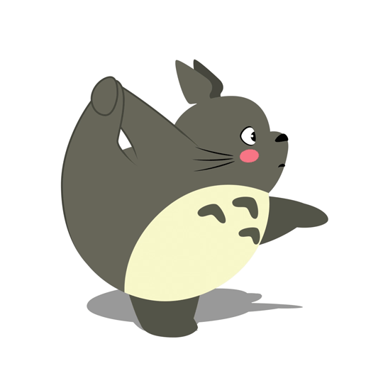
GRADE 5
PHYSICAL EDUCATION

Slide 2
Let’s get MOVING Grade 5’s!
It is extremely IMPORTANT to keep moving, keep fit and stay healthy.
Make sure to complete all the activities provided on a safe surface.
Make sure to complete the warm-up first before you continue
with the activity.
Today we will be
This will be followed by a few fitness activities.
GOOD LUCK!!

Slide 3
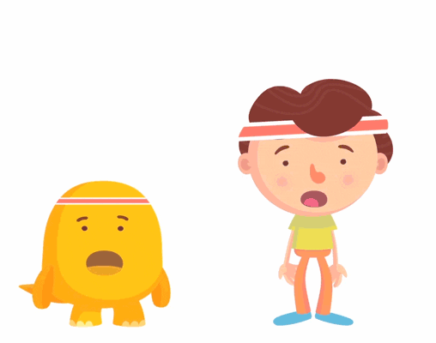
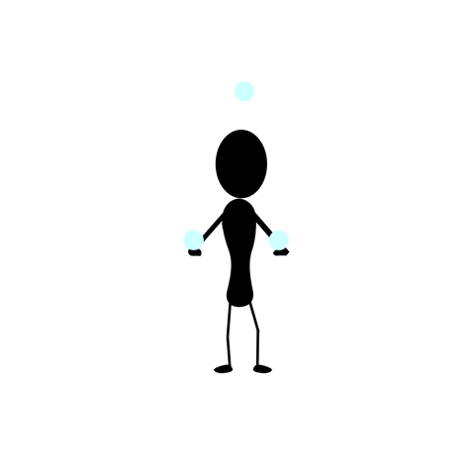
Good Luck!
Jumping Jacks
WARM-UP : Jumping jacks continuously for 3 minutes.
- Rest for 40 seconds then REPEAT.
-If you have a skipping rope or treadmill
( jump or run for 2 minutes ) and REPEAT.
ACTIVITY: Find two small tennis balls ( or any safe alternative that will fit comfortably in your hands) .
Place both balls in the palm of your hands and throw the ball upwards into the air at the same time. ( Repeat this 20 times ).
Now throw the ball in the left hand across to your right hand and the ball in your right hand into your left at the same time( Repeat 20 times).
Complete 2 minute of high knees while using your dominant hand to throw the ball up and down as many times as possible. Then complete another 2 minutes of high knees while using your opposite hand.
Now for a juggle challenge: Find 3 balls and try juggling them,, without dropping a single ball- start with 2 balls then introduce the 3rd ball.
COOL DOWN: stretch from your head to your toes ( hold each stretch for 10 seconds)
Juggling- Challenge

