Slide 1
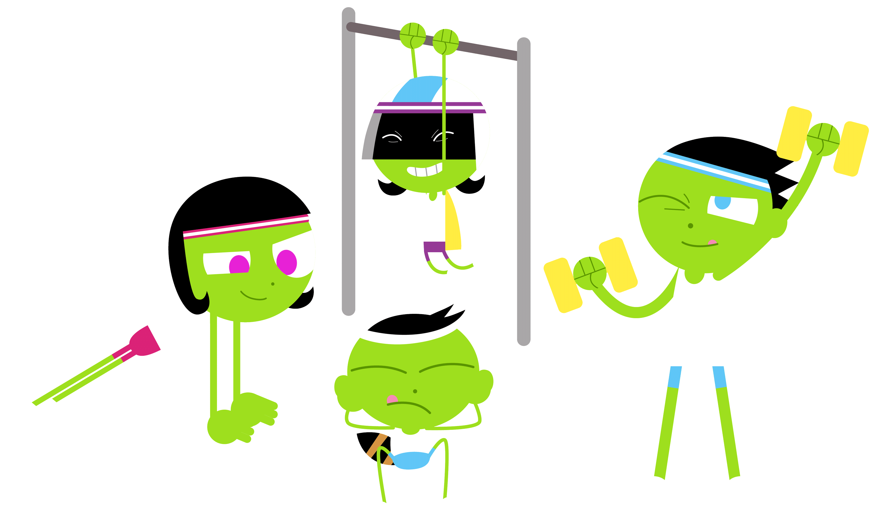
GRADE 6
PHYSICAL EDUCATION

Slide 2
LET’S GET MOVING! GOOD LUCK WITH YOUR WORKOUT.
It is extremely IMPORTANT to keep moving, keep fit and keep healthy.
Make sure to complete all the activities provided on a safe surface.
Make sure to complete the warm-up first before you continue
with the activity.
Today we will be doing
Core Exercises & a T-test.
This will be followed by a few fitness activities.
GOOD LUCK!!

Slide 3
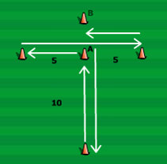
WARM-UP: Jumping Jacks for 4 minutes.
-If you have a treadmill- run for 4 minutes.
ACTIVITY: We are going to start off with a few core exercises then move onto another activity.
Sit-up challenge ( as many as you can complete in 2 minutes)
Plank- Hold your body straight and steady for 30 seconds
( x 2 )
Pike Jump - Hold plank position and then jump forward with your legs – Complete 20 JUMPS
REPEAT entire set if possible.
Find 4 cones or objects that can act like cones ( you can even use toilet rolls)
Set it up in a “ T “ formation.
Measure out your “T” by taking steps (shown on the example).
Follow the arrows from the bottom. Sprint this drill as fast as you can 3 times without stopping.
REPEAT 2 times- Make sure to rest for 1 minute between each.
COOL DOWN: Stretch after your exercises. Make sure to drink water too. Well done Grade 6’s.
PIKE JUMPS
T- Formation
IGNORE CONE B

