Slide 1
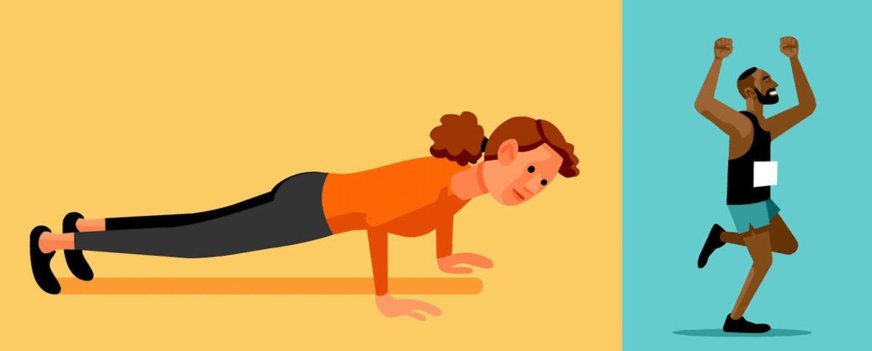
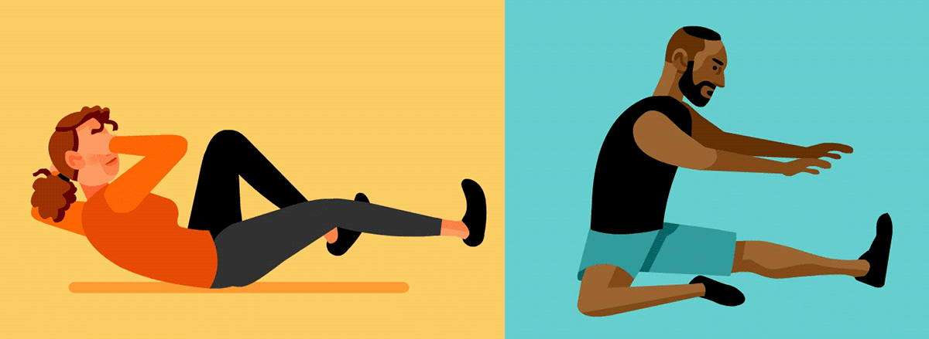
GRADE 7
PHYSICAL EDUCATION

Slide 2
It is extremely IMPORTANT to keep moving, keep fit and stay healthy. Make sure to complete all the activities provided on a safe surface. Make sure to complete the warm-up first before you continue with the activity. Today we will be doing many different exercises. This will hopefully challenge you and help improve your overall fitness. GOOD LUCK!!

Slide 3
There are 12 exercises alongside to choose from…
Complete your warm-up, then choose 6 to complete in 30 minutes.
Each exercise must be completed for a duration of 5 minutes non-stop.
Take 1 minute to rest between each exercise.

Slide 4
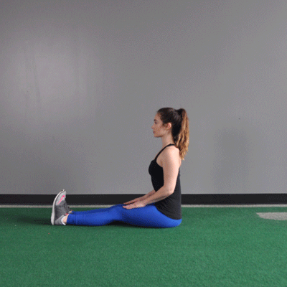
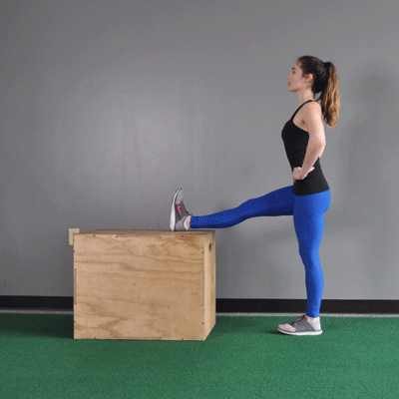
Warm-up Activity Cool Down
WARM-UP: Jumping Jacks ( continuously for 4 minutes)
ACTIVITY : Choose 6 exercises to complete for 5 minutes.
Options include:
Jumping Jacks, Sit-ups, Push-ups & Wall Sit.
Step-ups, squats, Tricep dips & Plank.
High knees, lunges, Push-up rotation & Side plank.
Rest for 1 minute between each only if necessary.
COOL DOWN: Jog on the spot slowly for 2 minutes followed by a light stretch ( Full Body ).
WELL DONE GRADE 7’S! Make sure to drink water afterwards.

