Slide 1
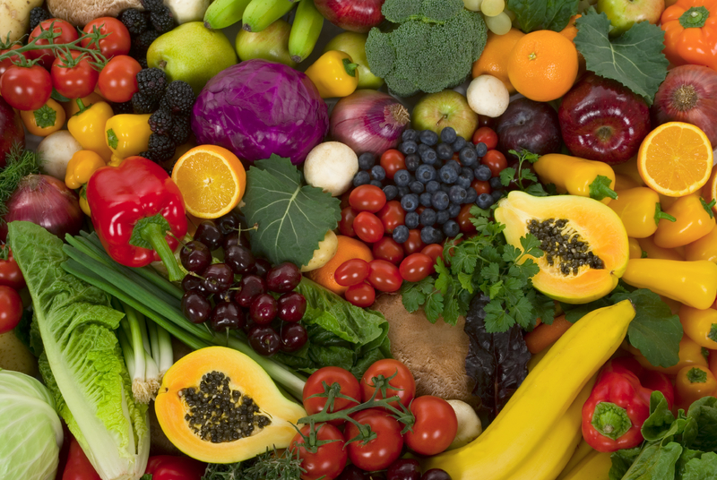
Dijo
Food

Slide 2
Khabetšhe
Cabbage

Slide 3
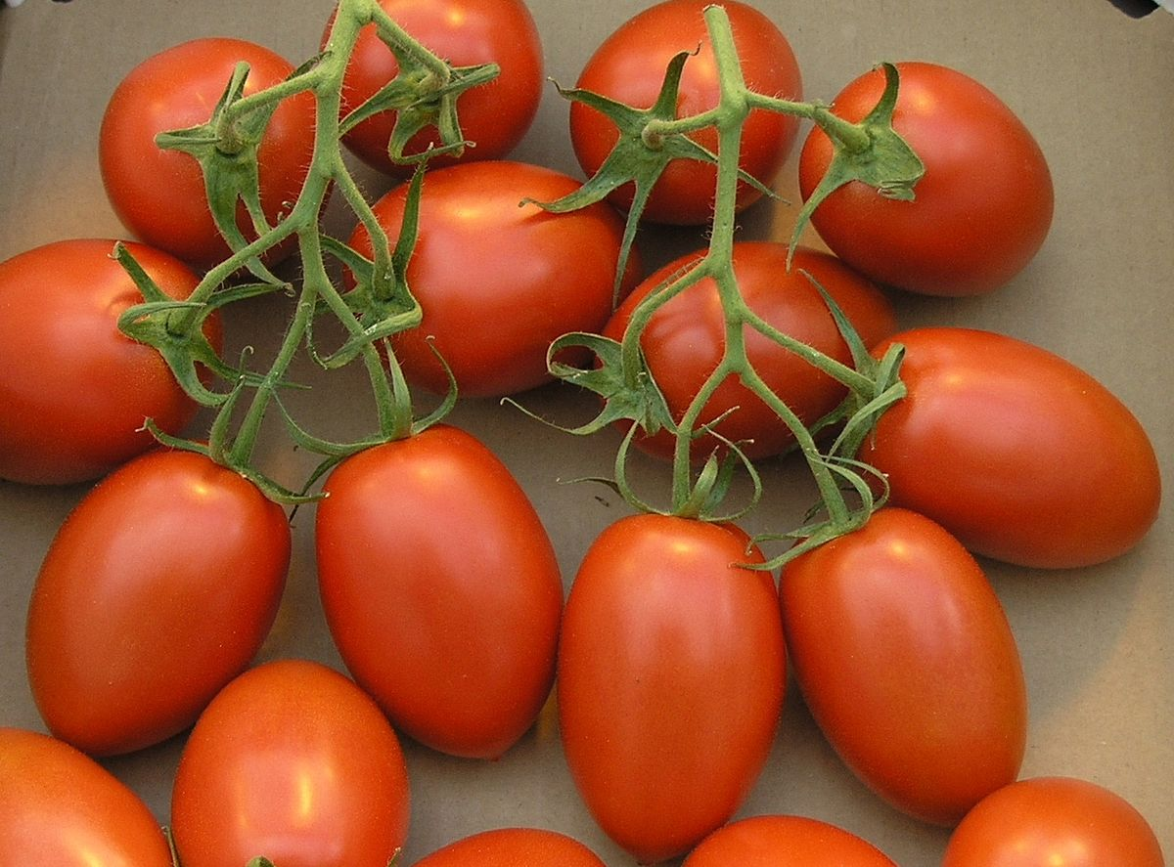
Ditamati
Tomatoes

Slide 4
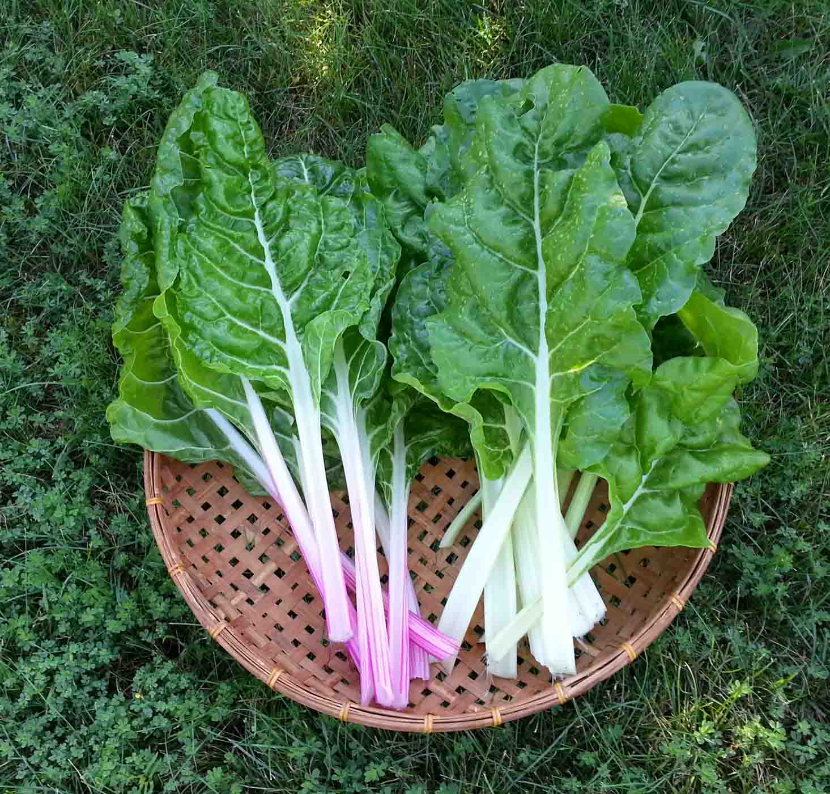
Sepenetšhe
Spinach

Slide 5
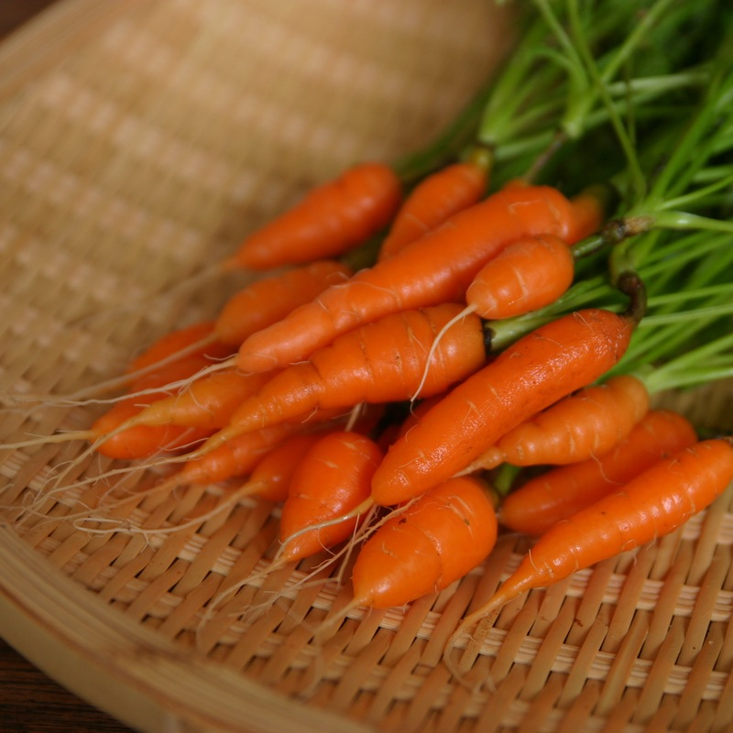
Dikherote
Carrots

Slide 6
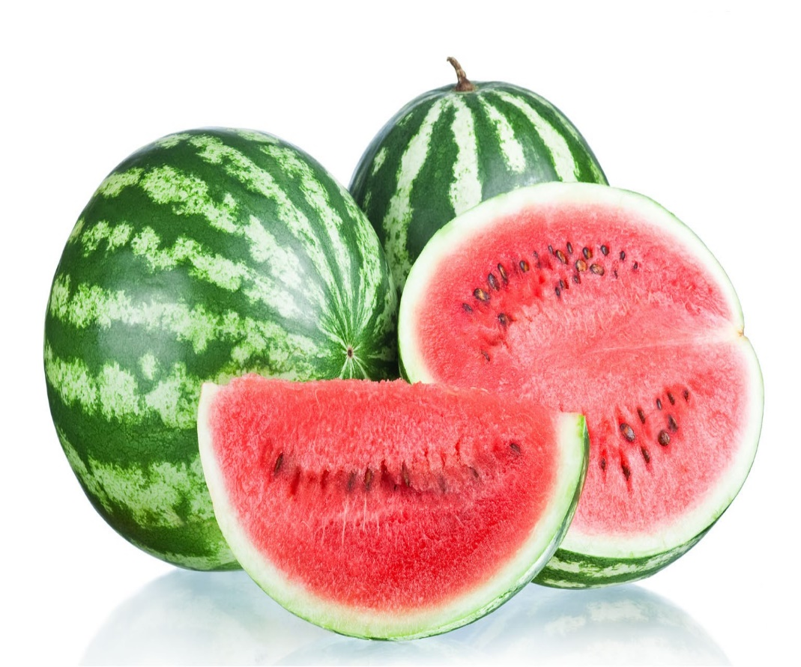
Legapu
Watermelon

Slide 7
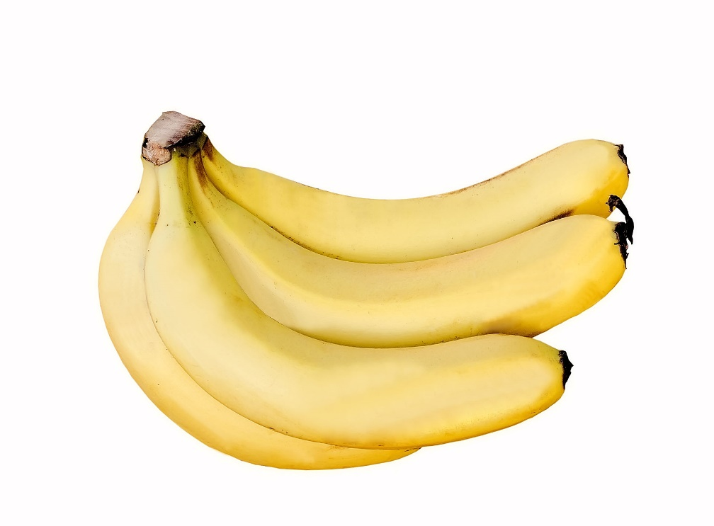
Dipanana
Bananas

Slide 8
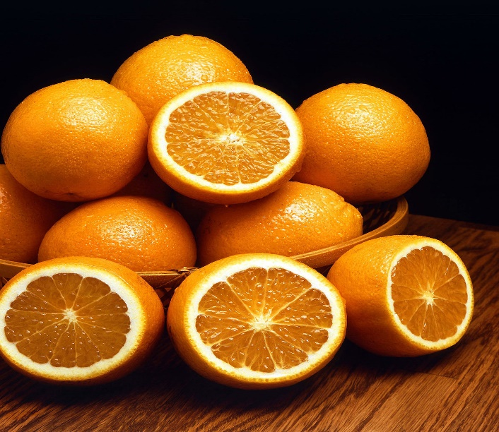
Dinamune
Oranges

Slide 9
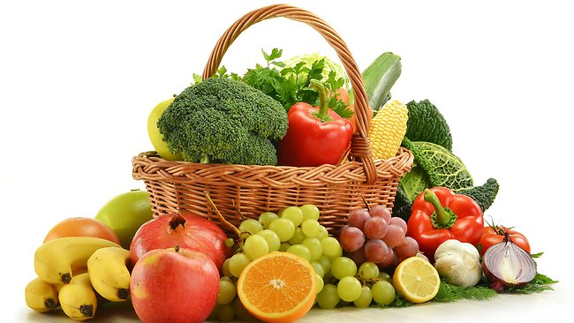
Merogo le dienywa
Vegetables and fruits

