Slide 1
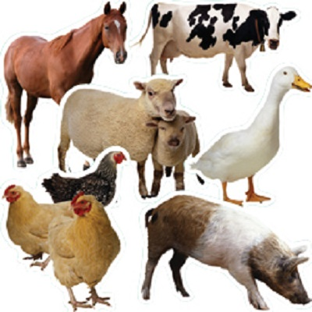
Diphoofolo tša polaseng
Farm animals

Slide 2
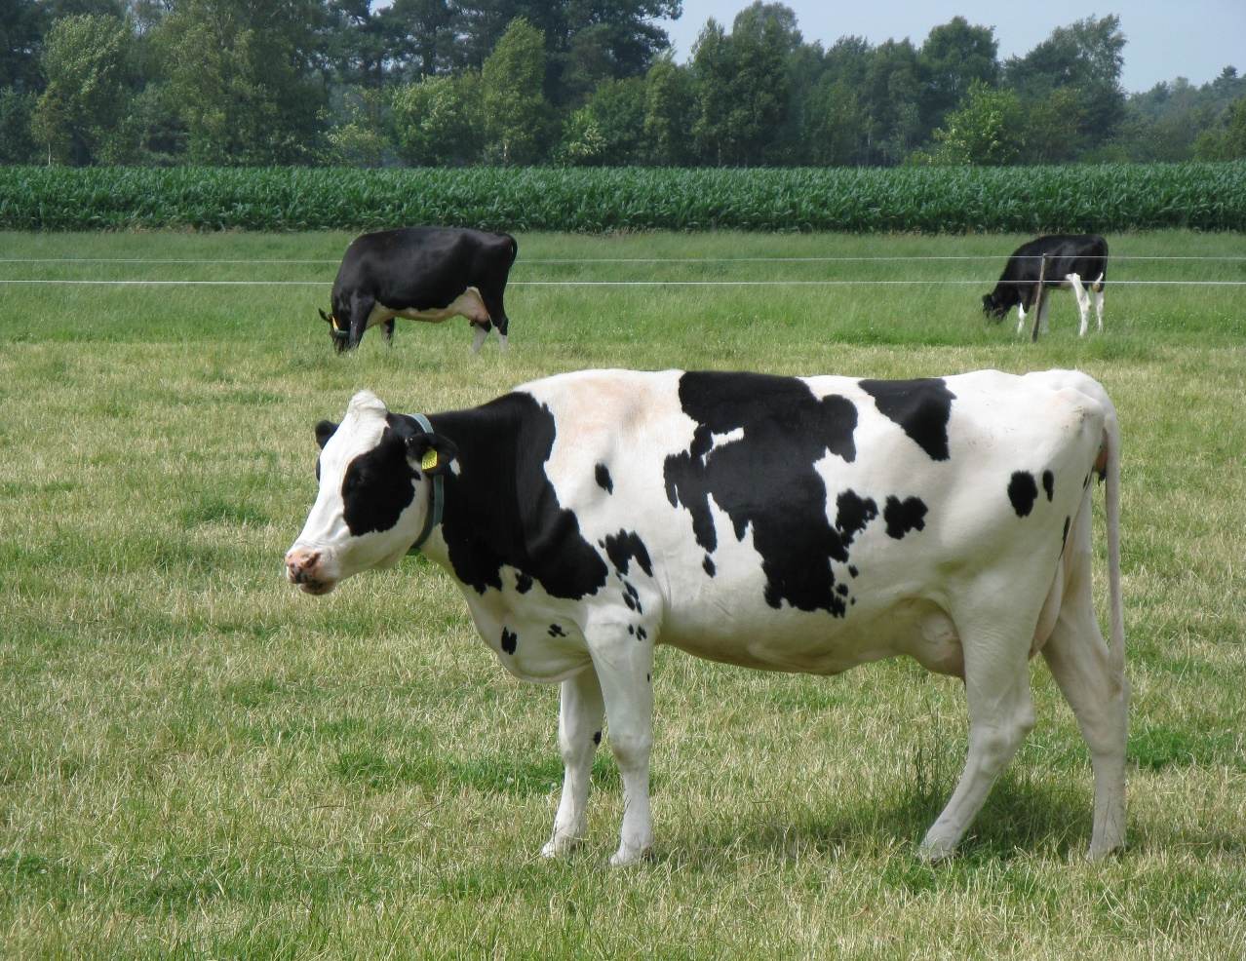
Dikgomo
Cows

Slide 3
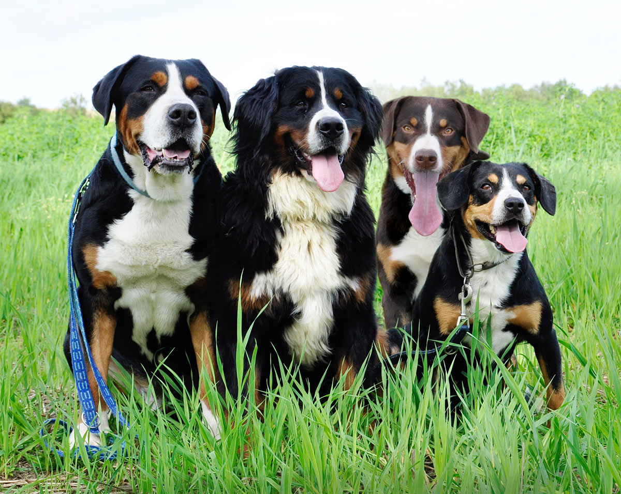
Dimpša
Dogs

Slide 4
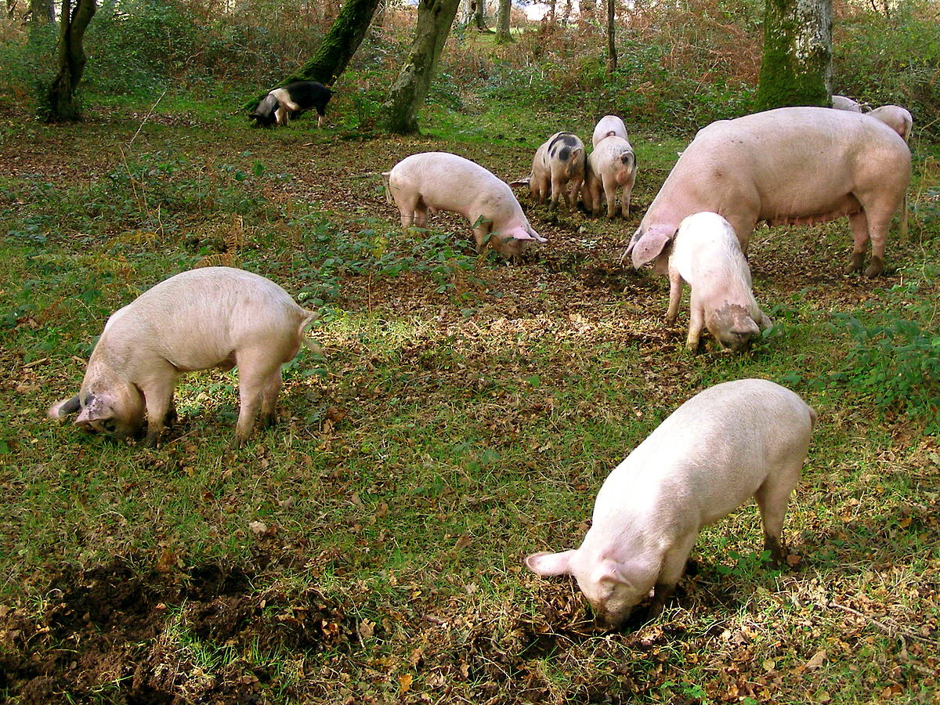
Dikolobe
Pigs

Slide 5
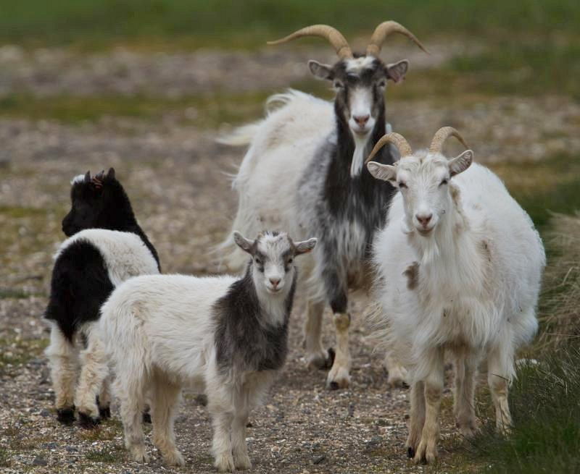
Dipudi
Goats

Slide 6
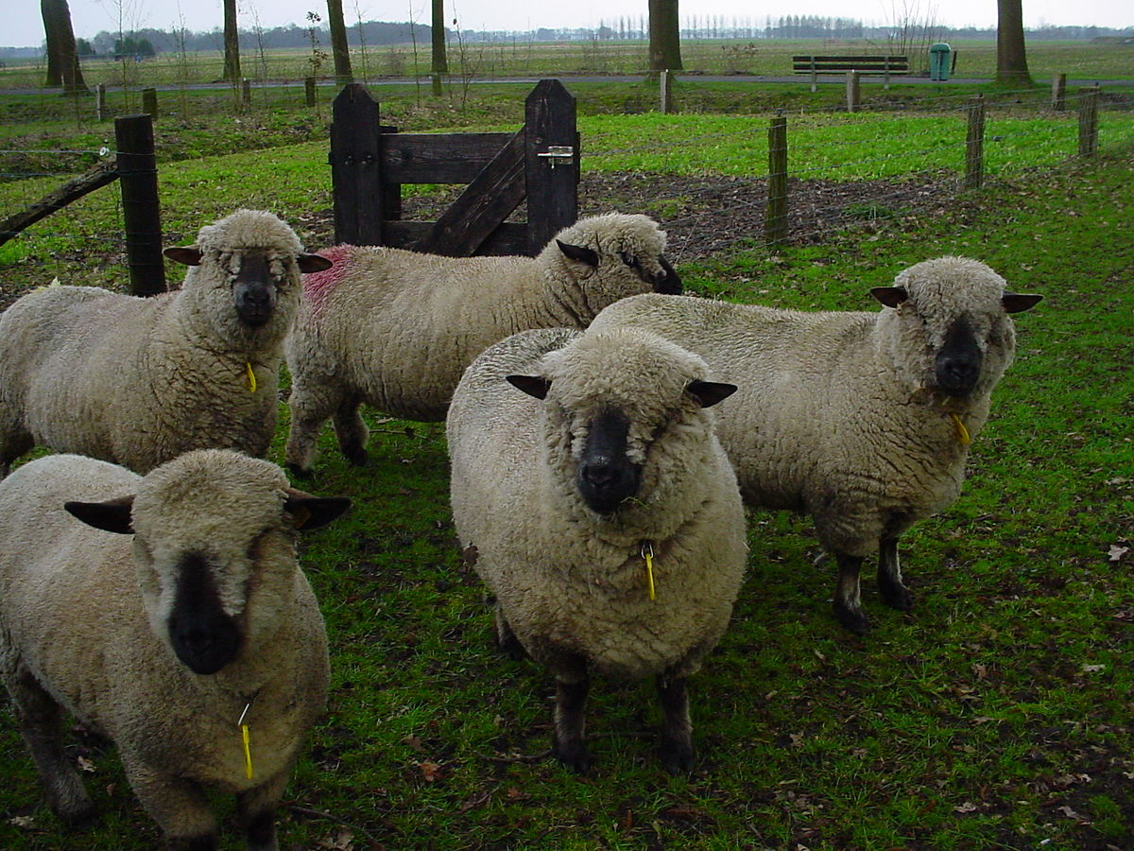
Dinku
Sheep

Slide 7
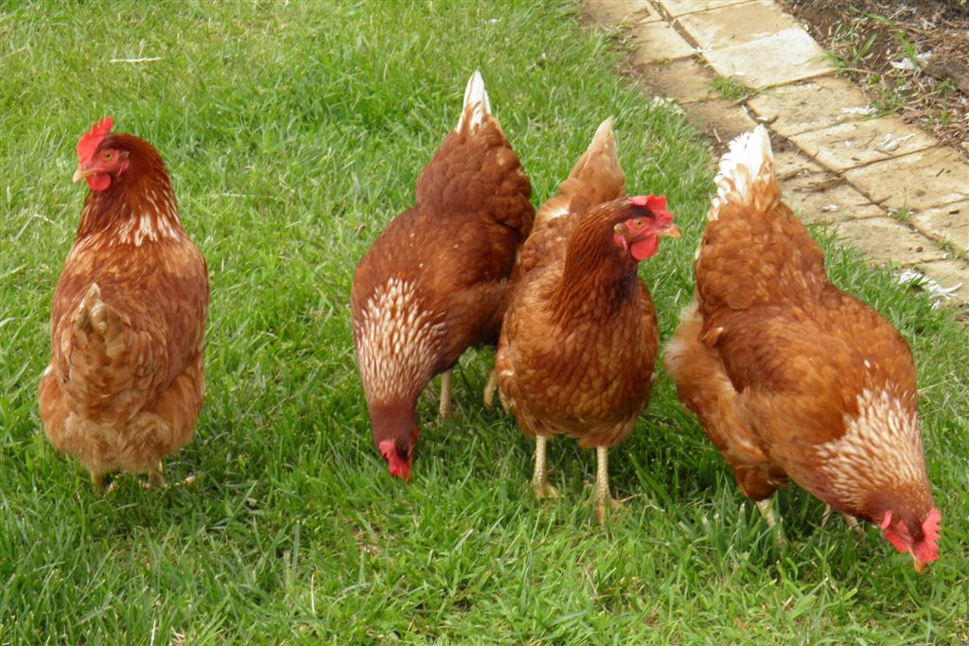
Dikgogo
Chickens

Slide 8
