Slide 1
Diaparo tša sekolo.
School clothes.

Slide 2
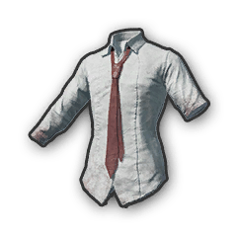
Hempe ya sekolo.
School shirt.

Slide 3
Sekhethe sa sekolo.
School skirt.

Slide 4
Thai ya sekolo.
School tie.

Slide 5
Roko ya sekolo.
School dress.

Slide 6
Jase ya sekolo.
School jacket.

Slide 7
Borokgo ba sekolo.
School trouser.

Slide 8
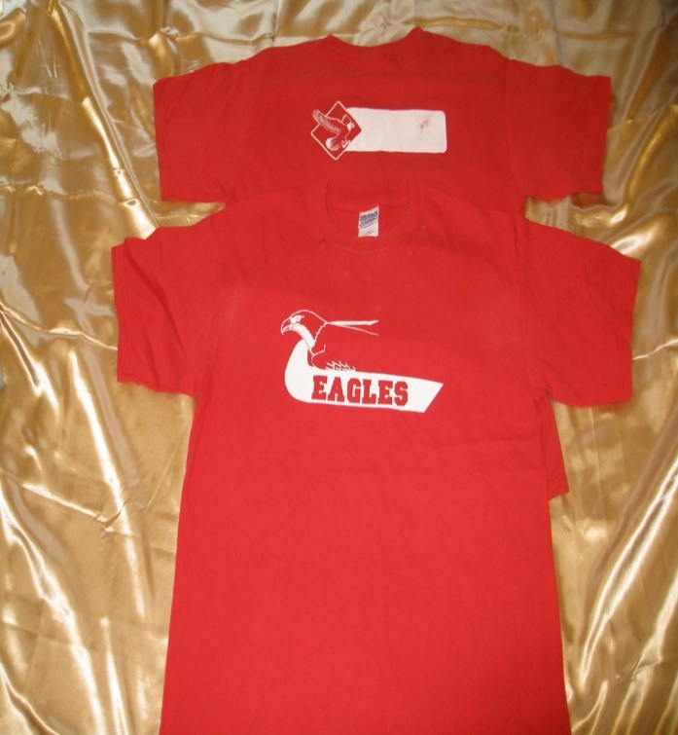
Sekhipa sa sekolo.
School t-shirt

Slide 9
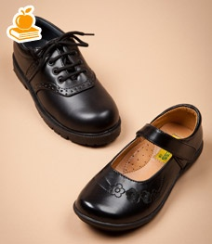
Dieta tša sekolo.
School shoes.

Slide 10
Masokisi a sekolo.
School socks.

Slide 11
