Slide 1
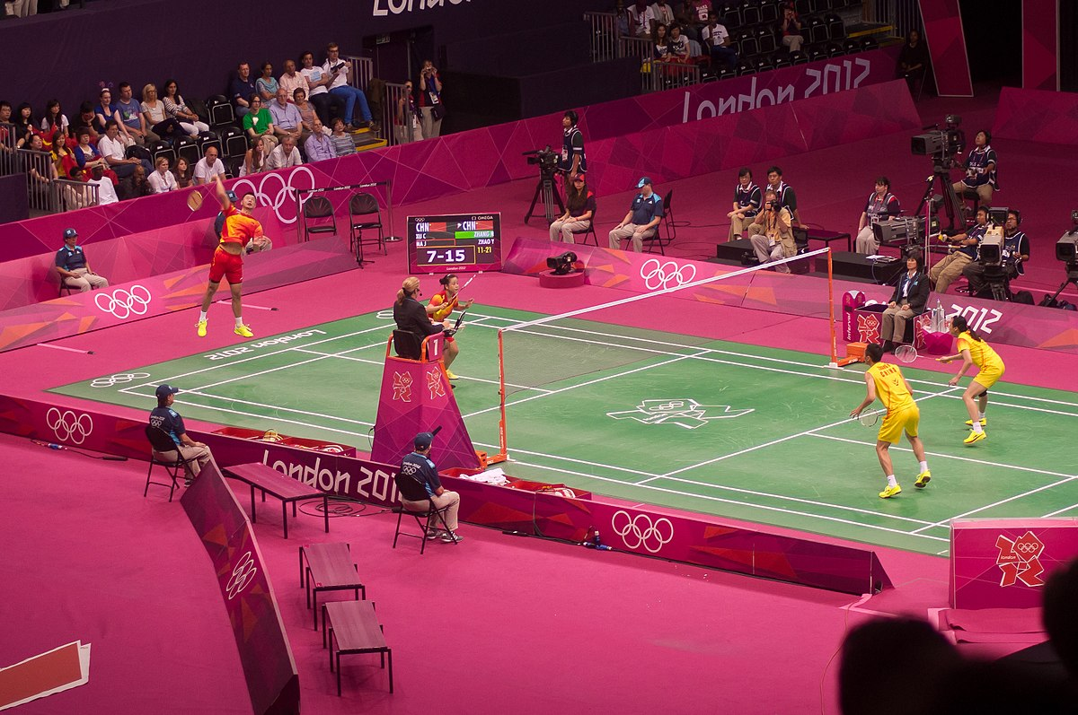
Dipapadi.
Sports.

Slide 2
Ba bapala kgwele ya maoto.
They are playing soccer.

Slide 3
Ba bapala rakebi.
They are playing rugby.

Slide 4
Ba bapala khirikhete.
They are playing cricket.

Slide 5
Ba bapala hokhi.
They are playing hockey.

Slide 6
Ba bapala thenisi.
They are playing tennis.

Slide 7
O thutha ka meetseng.
Swimming in the water.

Slide 8
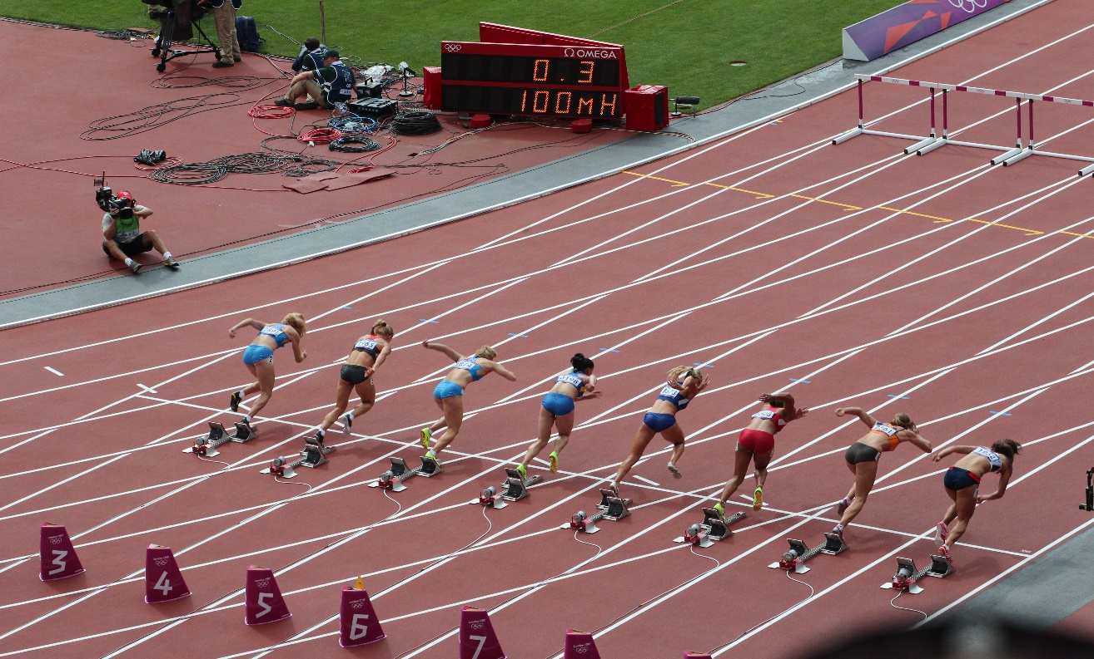
Ba kitima diatletiking.
They are running at the athletics.

Slide 9
