Slide 1
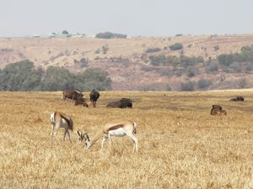
Diphoofolo tša nageng.
Wild animals.

Slide 2
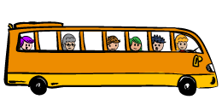
Re ya lešokeng la diphoofolo ka pese ye kgolo.
We are going to the Game Reserve in a big bus.

Slide 3
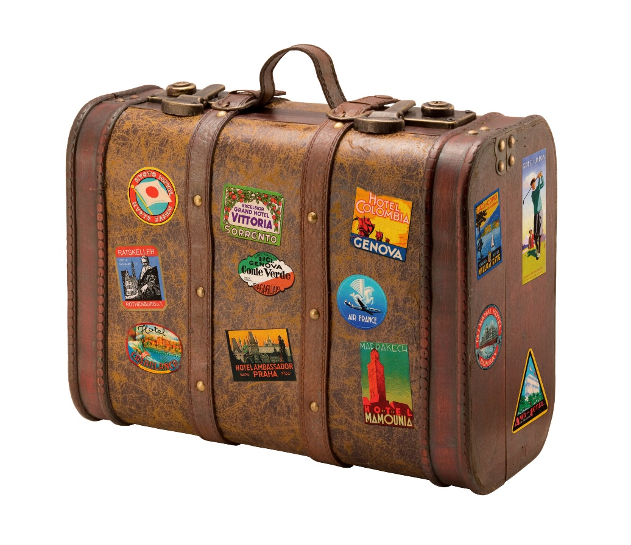
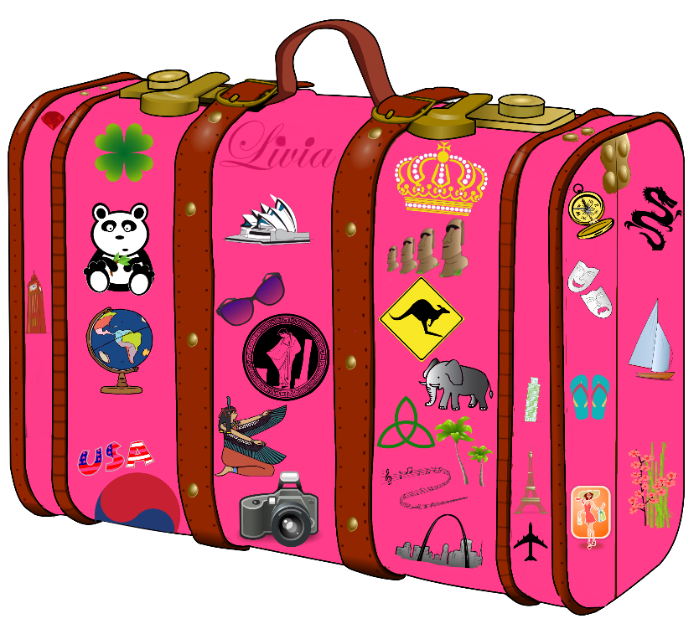
Re phutha dikheisi tša rena.
We pack our cases.

Slide 4
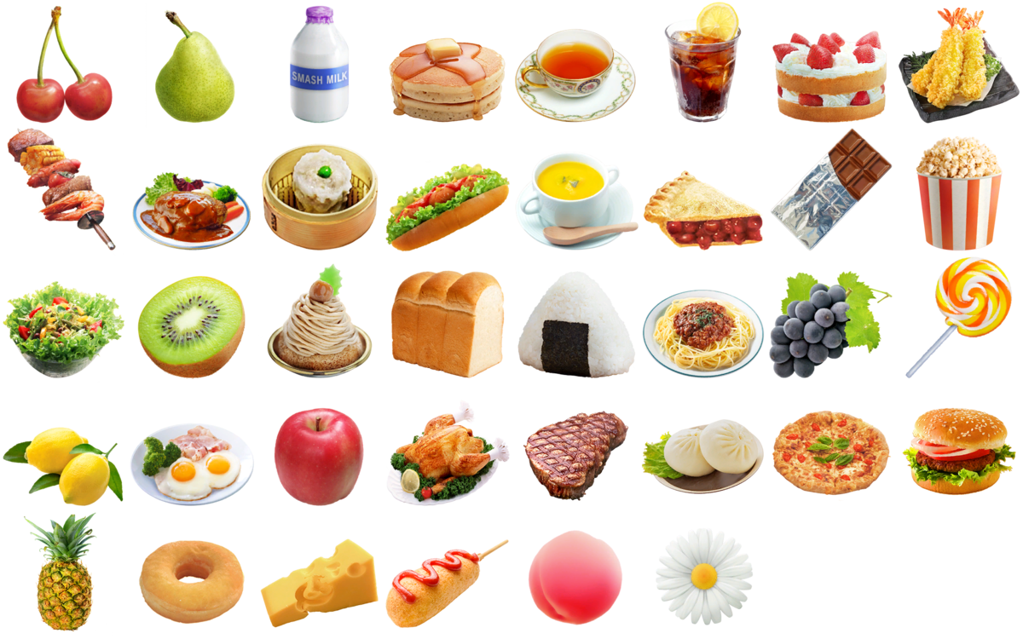
Re phutha le dijo tša rena.
We pack our food.

Slide 5
Ra šadiša bomma lebotate gabotse.
We say goodbye to mommy and daddy.

Slide 6
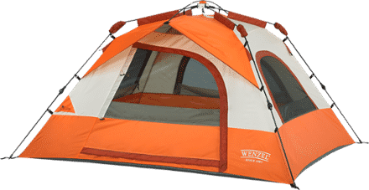
Re ile ra robala ka tenteng.
We slept in a tent.

Slide 7
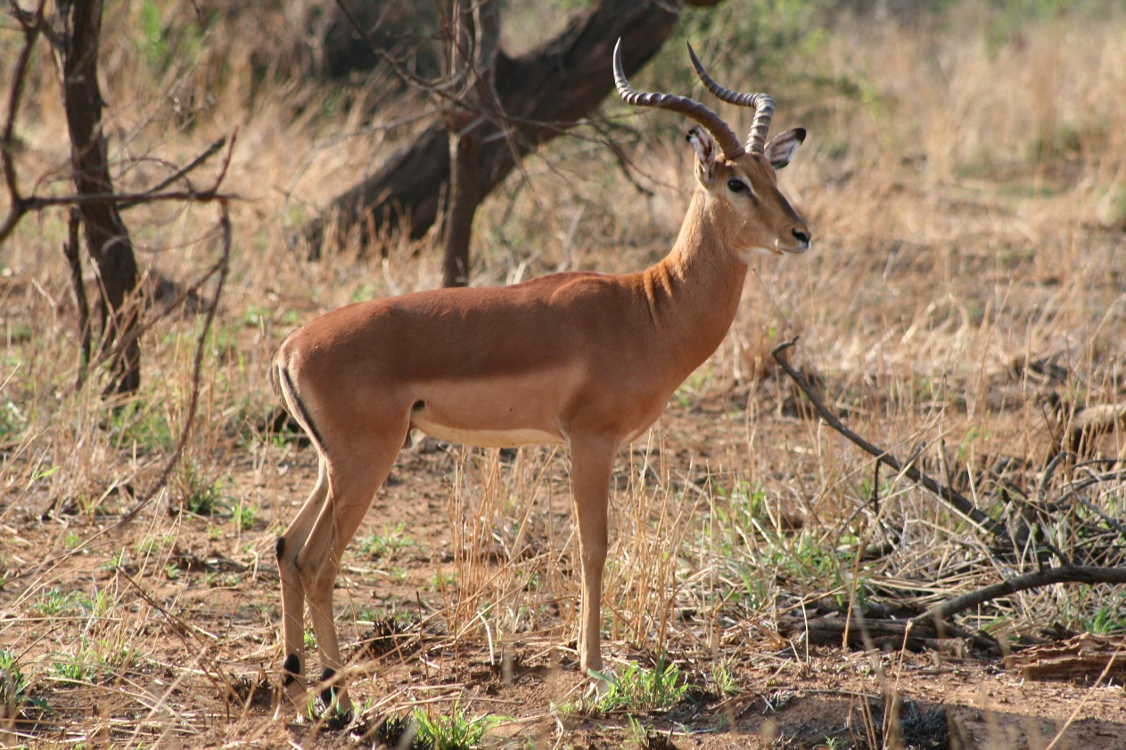
Re bone phala ye botse.
We saw a beautiful buck.

Slide 8
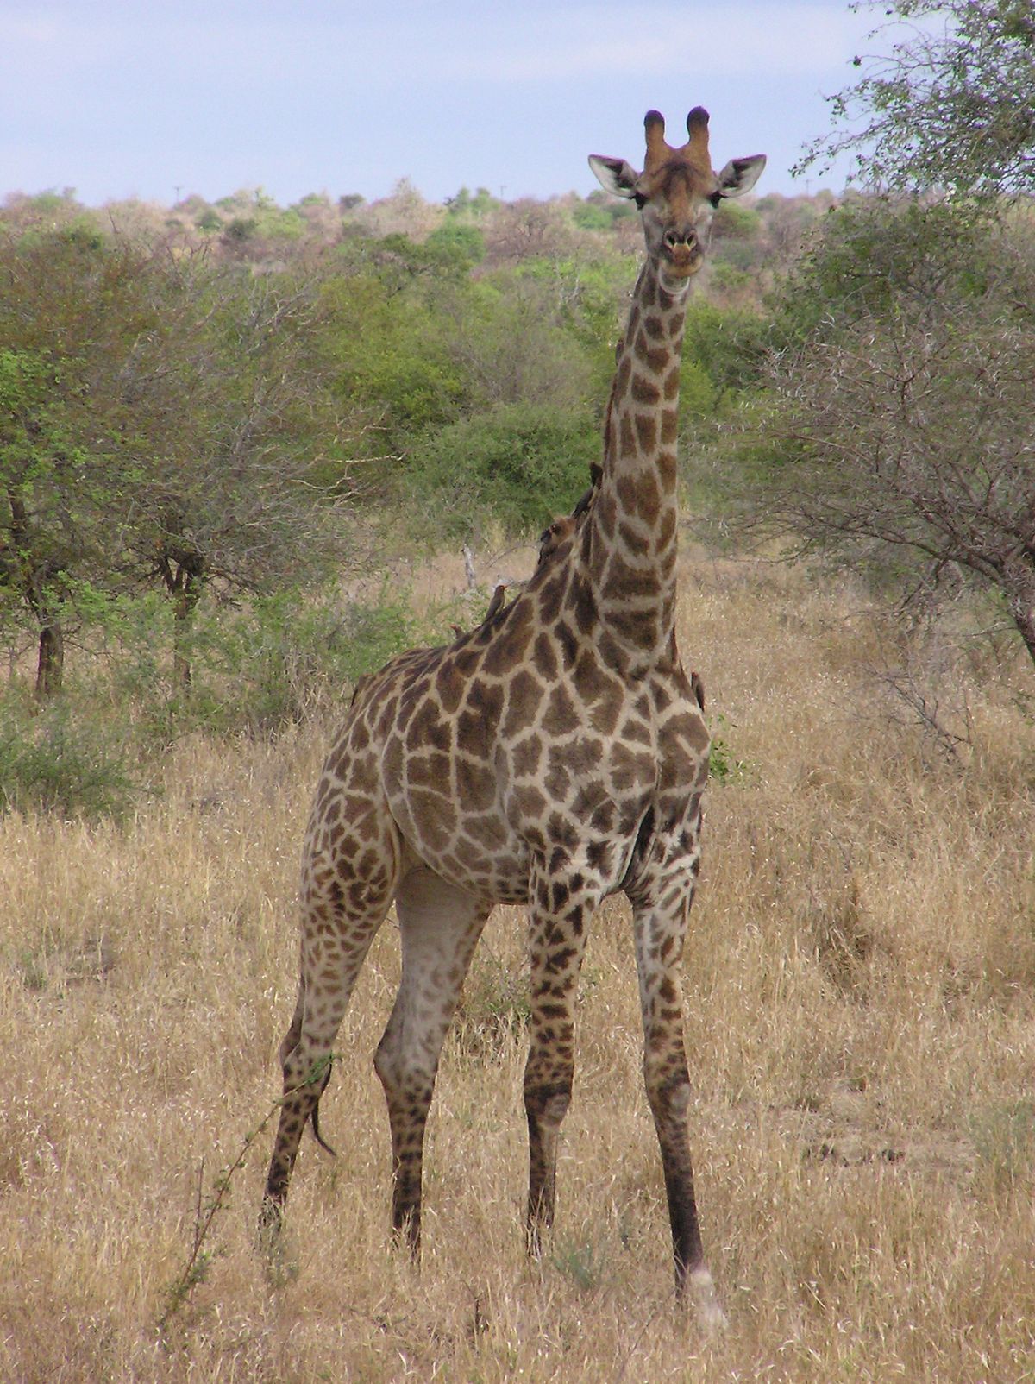
Ra bona le thutlwa ya molala yo motelele.
We saw a giraffe with a long neck.

Slide 9
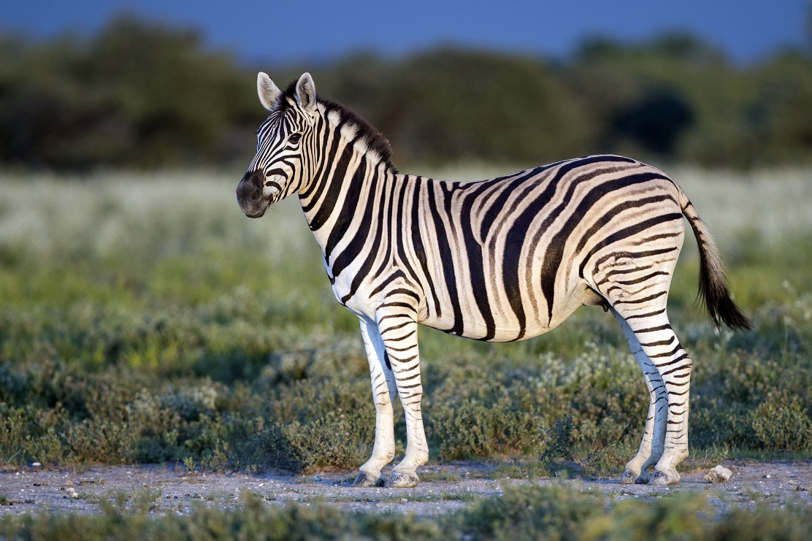
Ra bona le pitsi.
We saw a zebra.

Slide 10
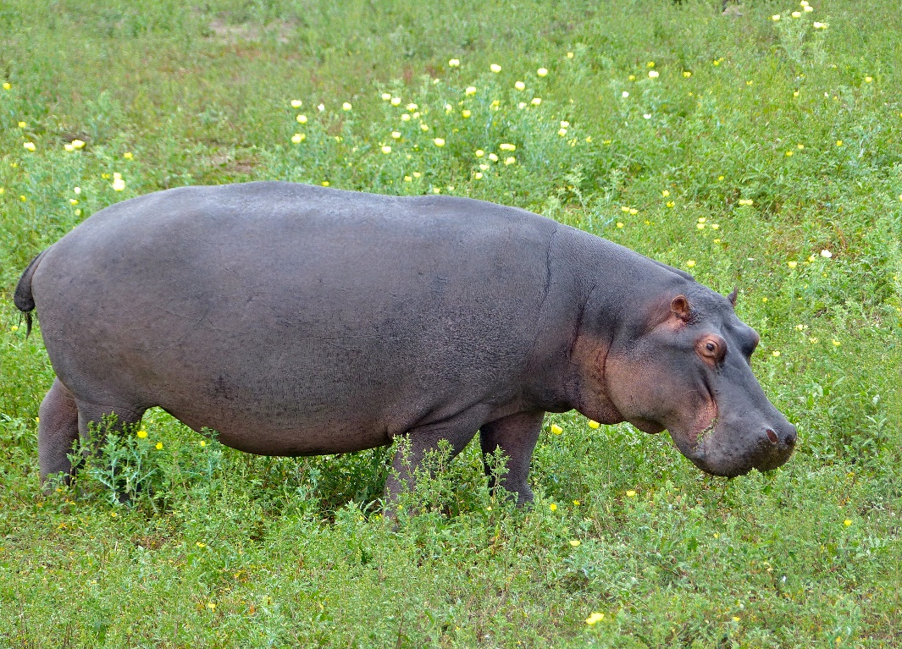
Re bone kubu.
We saw a hippo.

Slide 11
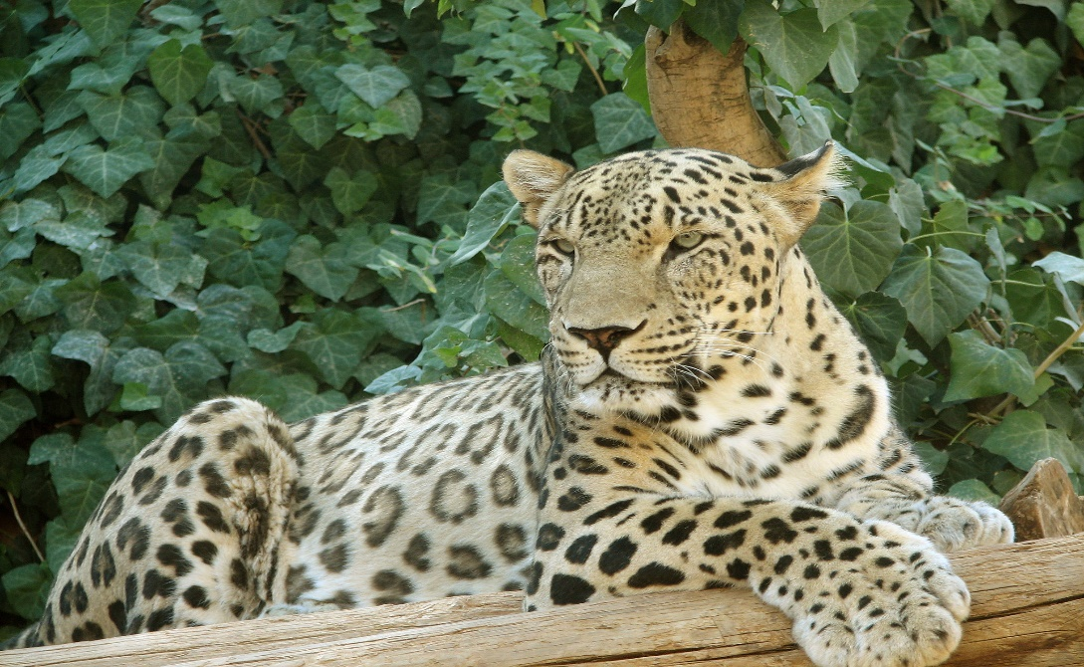
Re bone le nkwe mohlareng.
We saw a leopard on the tree.

Slide 12
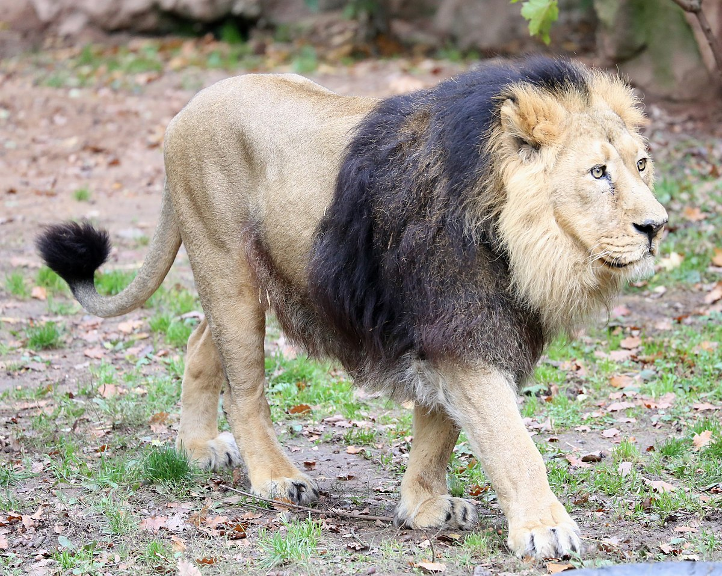
Ra bona le tau.
We saw a lion.

Slide 13
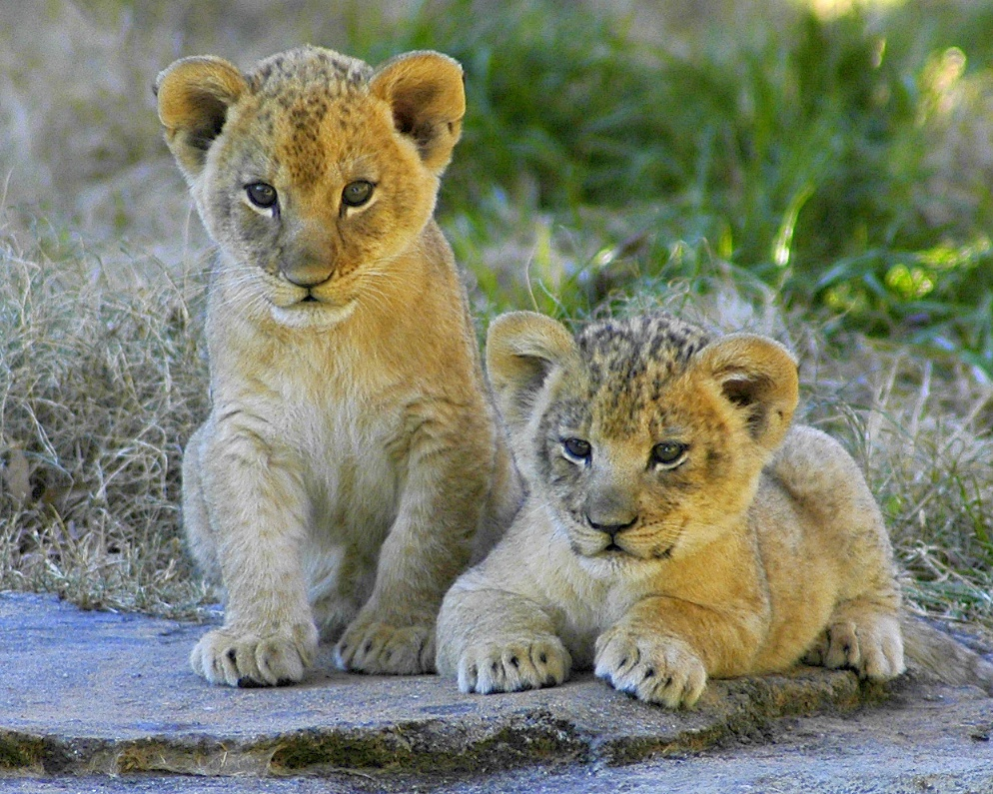
Ra bona ditawana di dutše fase.
We also saw lion cubs.

Slide 14
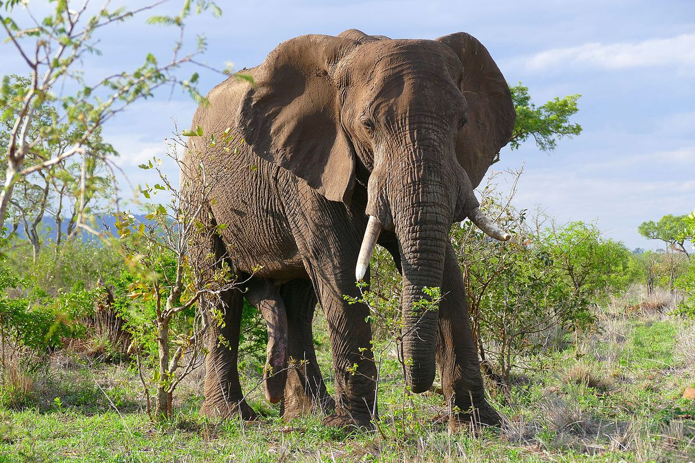
Re ile ra bona le tlou.
We saw an elephant.

Slide 15
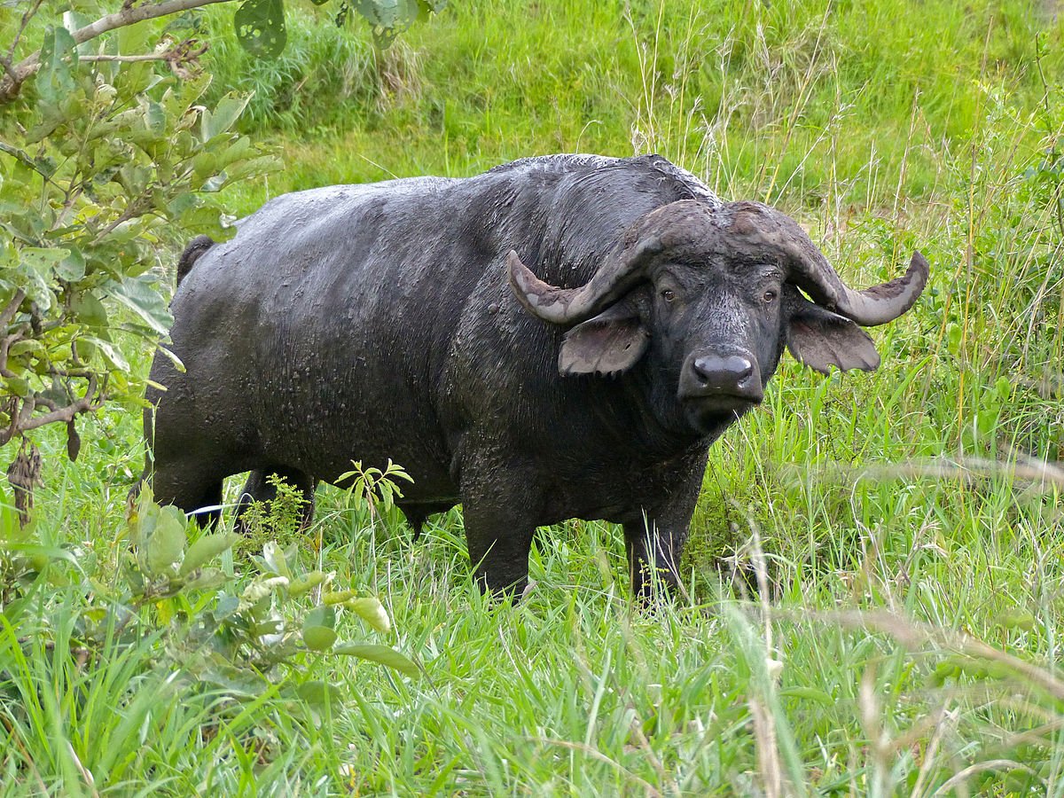
Re ile ra bona le nare.
We saw a
buffalo.

Slide 16
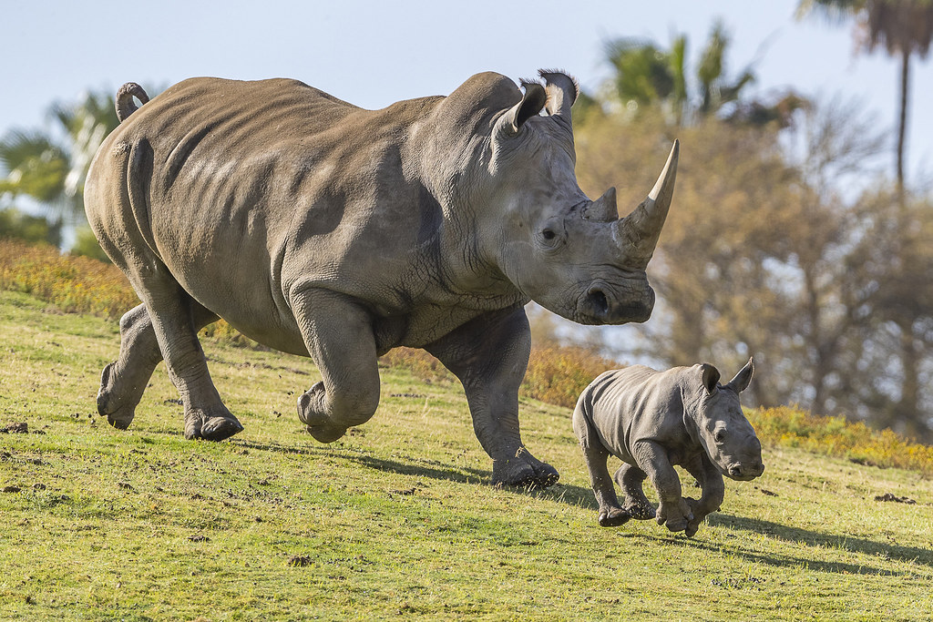
Ra bona le tšhukudu.
We saw a rhino.

Slide 17
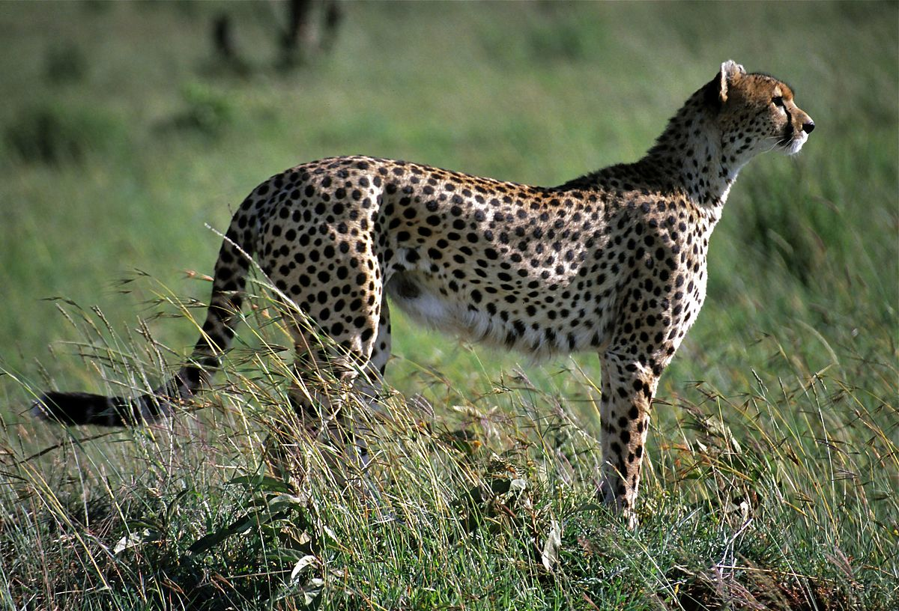
Aowa ga re a bona lengau.
We didn’t see a cheetah.

Slide 18
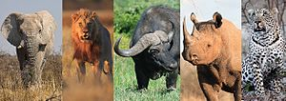
Ka mahlatse re bone sehlano se segolo!
Luckily we saw the big five!

Slide 19
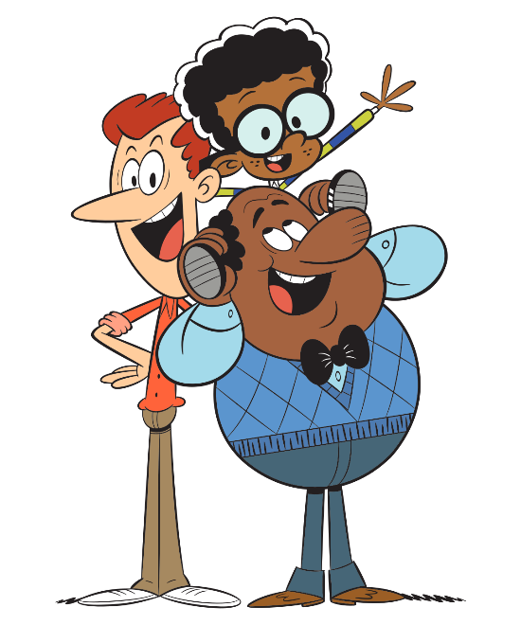
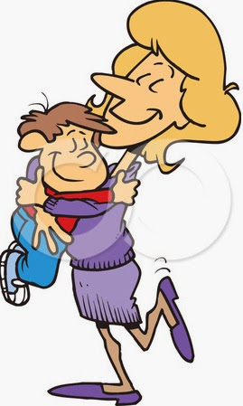
Re thabetše go bona bomma le botate gape.
We are happy to see Mommy and Daddy.

