Slide 1
Batho ba go re thuša
People who help us

Slide 2
Raposo
Postman

Slide 3
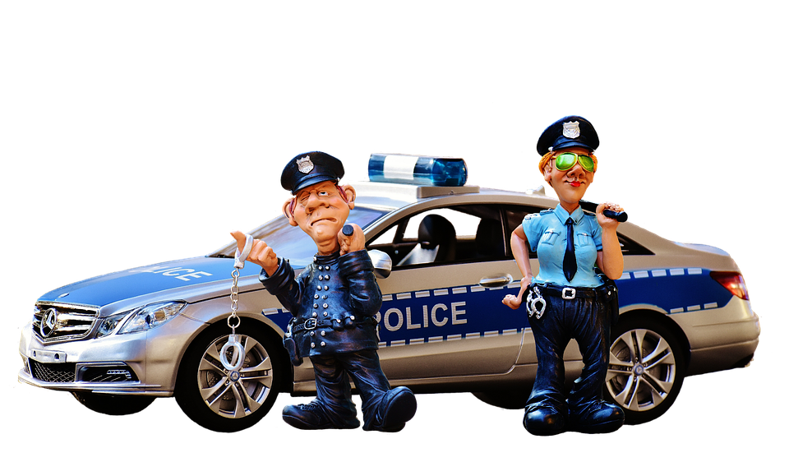
Maphodisa
Police

Slide 4
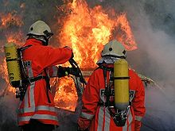
Rasetimamollo
Firefighter

Slide 5
Morutiši
Teacher

Slide 6
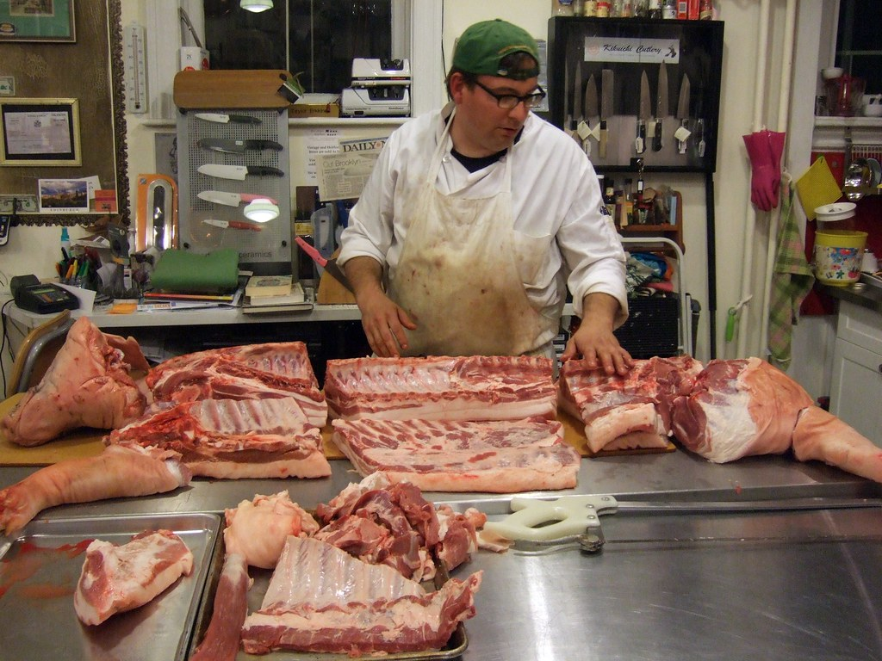
Raleselaga
Butcher

Slide 7
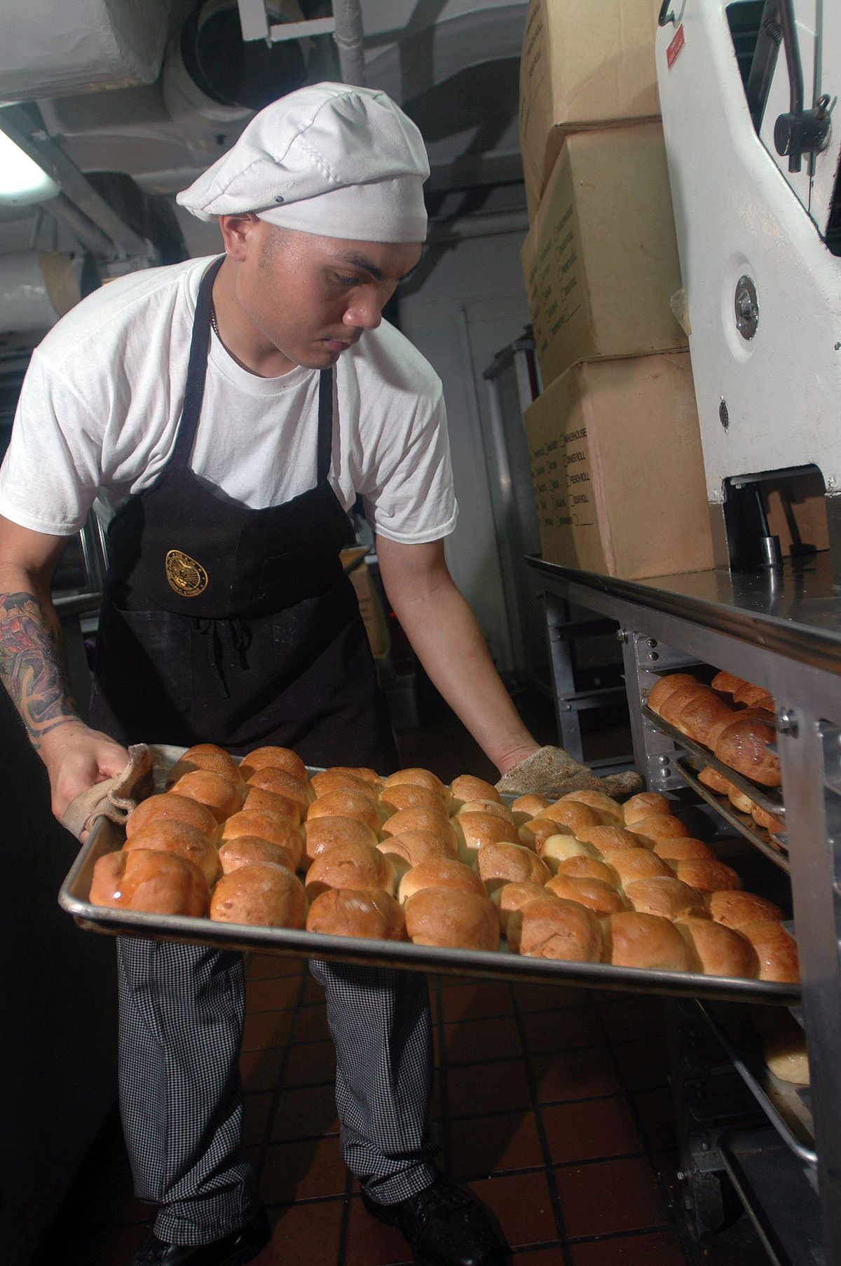
Mopaki
Baker

Slide 8
Rabokgobapuku
Librarian

Slide 9
Makhaniki
Mechanic

Slide 10
Ngaka
Doctor

